Slide 1
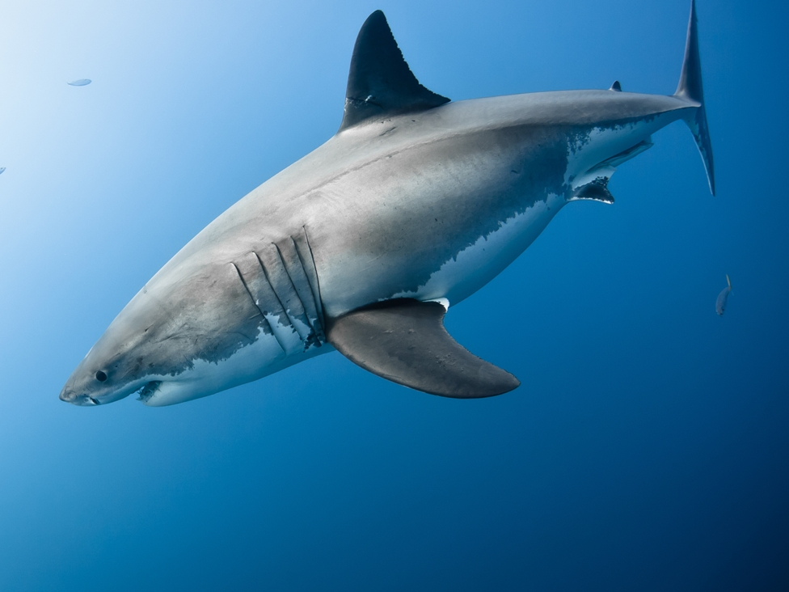
Using Acoustic Telemetry Data and Environmental Variables to Predict White Shark Presence in Southern California
Photo by Ralph Pace
Echelle Burns – Jan 2020

Slide 2

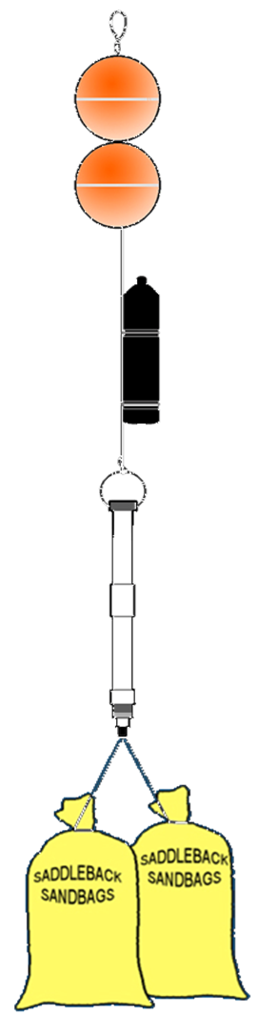
Introduction: Acoustic Telemetry
Common tool to study animal movement
Transmitters emit ultrasonic sound
Acoustic receiver picks up transmitter signal
Records: Date, Time, Transmitter Code, Mooring Location
Notes:
In acoustic telemetry, fish are typically fitted with acoustic transmitter that emit a sound wave that is picked up by underwater acoustic receivers. The receiver records the date, time, and tagID of the individual that was within its detection range.
The transmitters used for this study were Vemco V9 transmitters. they randomly send out a signal every 100 to 180 seconds, have a battery life of about one year, and a nominal detection distance of about 500 m.

Slide 3
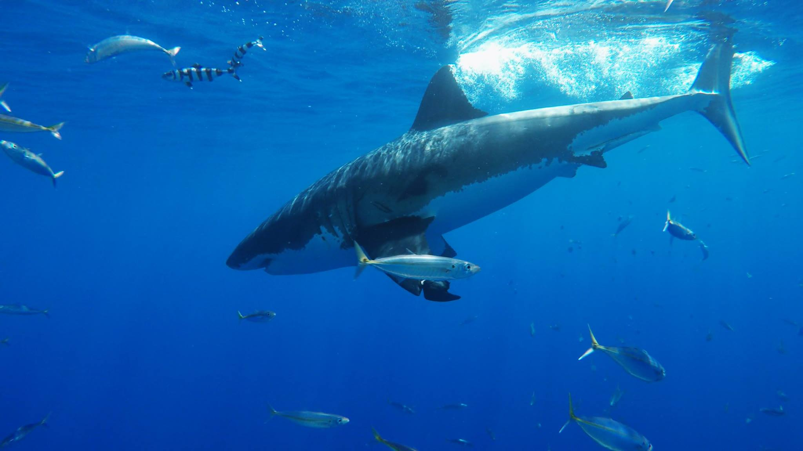
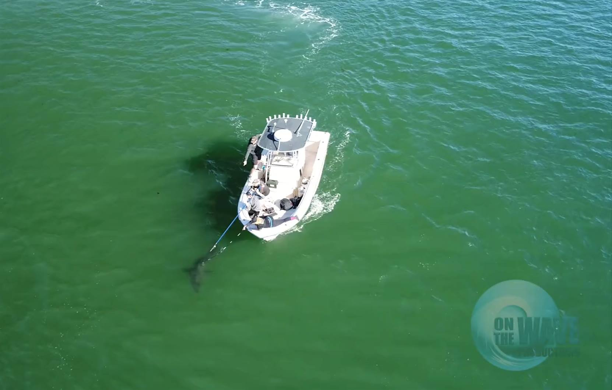
Introduction: Study Species
Juvenile White Sharks (Carcharodon carcharias)
Apex predator with a global distribution
Repeated movements to nearshore waters off southern California
Seasonal/annual scale
Running hypothesis: Temperature Driven?
Notes:
In acoustic telemetry, fish are typically fitted with acoustic transmitter that emit a sound wave that is picked up by underwater acoustic receivers. The receiver records the date, time, and tagID of the individual that was within its detection range.
The transmitters used for this study were Vemco V9 transmitters. they randomly send out a signal every 100 to 180 seconds, have a battery life of about one year, and a nominal detection distance of about 500 m.

Slide 4
Introduction: Project Objectives
Objectives:
Determine which combinations of environmental parameters influence White Shark presence in southern CA
Predict ranges of environmental conditions that are most likely to result in high densities of White Sharks
Audience:
Researchers using similar species or technology
Lifeguards and public safety personnel
Notes:
In acoustic telemetry, fish are typically fitted with acoustic transmitter that emit a sound wave that is picked up by underwater acoustic receivers. The receiver records the date, time, and tagID of the individual that was within its detection range.
The transmitters used for this study were Vemco V9 transmitters. they randomly send out a signal every 100 to 180 seconds, have a battery life of about one year, and a nominal detection distance of about 500 m.

Slide 5
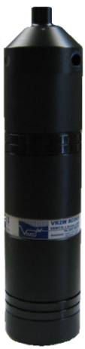
Materials and Methods: Data Sources
Cal State University, Long Beach Shark Lab:
Receiver Deployment Log
When and where receivers were deployed
Transmitter Deployment Log
Tagging date, location, species
Receiver Data (2012 – 2019)
Detection data from nearby animals
Notes:
In acoustic telemetry, fish are typically fitted with acoustic transmitter that emit a sound wave that is picked up by underwater acoustic receivers. The receiver records the date, time, and tagID of the individual that was within its detection range.
The transmitters used for this study were Vemco V9 transmitters. they randomly send out a signal every 100 to 180 seconds, have a battery life of about one year, and a nominal detection distance of about 500 m.

Slide 6
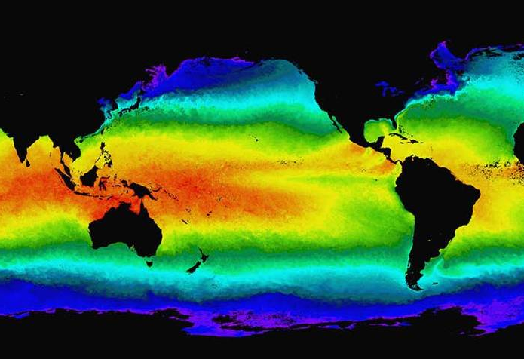
Materials and Methods: Data Sources
NOAA CoastWatch ERDDAP
Sea Surface Temperature (SST)
Sea Surface Salinity (SSS)
Chlorophyll-A
Seafloor Depth Gradient (seafloor slope)
Pylunar package – lunar phase
Notes:
In acoustic telemetry, fish are typically fitted with acoustic transmitter that emit a sound wave that is picked up by underwater acoustic receivers. The receiver records the date, time, and tagID of the individual that was within its detection range.
The transmitters used for this study were Vemco V9 transmitters. they randomly send out a signal every 100 to 180 seconds, have a battery life of about one year, and a nominal detection distance of about 500 m.

Slide 7
Materials and Methods: Data Cleaning
Acoustic Receiver Data
White Sharks (WS) only
Individual heard 2+ times per day at a receiver
Receiver confirmed to have been in the water
Latitude/Longitude reflect receiver deployment location
Result: WS detection data from 2014 to 2019
WS 01 2017-11-01 11:52:01
WS 01 2017-11-01 12:11:58
Notes:
In acoustic telemetry, fish are typically fitted with acoustic transmitter that emit a sound wave that is picked up by underwater acoustic receivers. The receiver records the date, time, and tagID of the individual that was within its detection range.
The transmitters used for this study were Vemco V9 transmitters. they randomly send out a signal every 100 to 180 seconds, have a battery life of about one year, and a nominal detection distance of about 500 m.

Slide 8
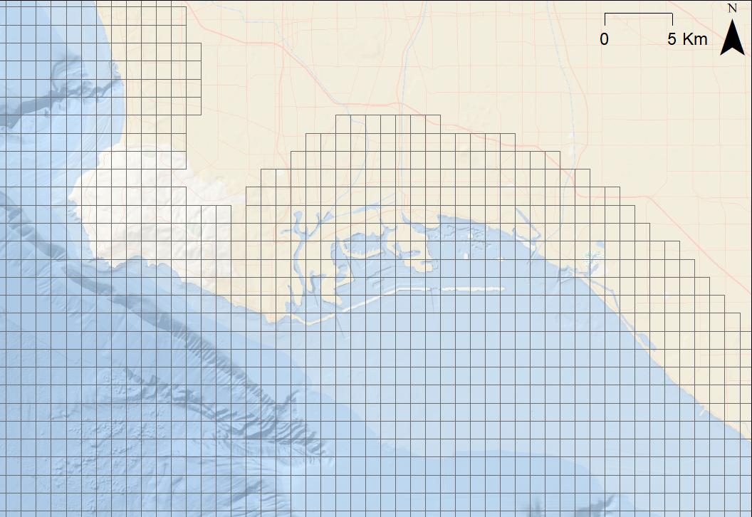
Materials and Methods: Data Cleaning
Fishnet 0.01 x 0.01 decimal degree (ArcMap)
Long Beach, CA
To merge environmental data with acoustic receiver data
Notes:
In acoustic telemetry, fish are typically fitted with acoustic transmitter that emit a sound wave that is picked up by underwater acoustic receivers. The receiver records the date, time, and tagID of the individual that was within its detection range.
The transmitters used for this study were Vemco V9 transmitters. they randomly send out a signal every 100 to 180 seconds, have a battery life of about one year, and a nominal detection distance of about 500 m.

Slide 9
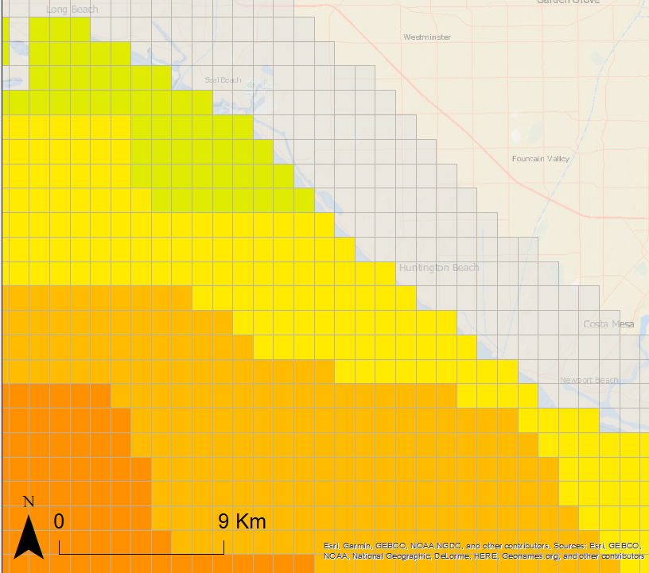
Materials and Methods: Data Cleaning
Fishnet 0.01 x 0.01 decimal degree (ArcMap)
Long Beach, CA
Nearest Neighbor for cells too close to shore
Mean value if > 1 measurements per cell
To merge environmental data with acoustic receiver data
Notes:
In acoustic telemetry, fish are typically fitted with acoustic transmitter that emit a sound wave that is picked up by underwater acoustic receivers. The receiver records the date, time, and tagID of the individual that was within its detection range.
The transmitters used for this study were Vemco V9 transmitters. they randomly send out a signal every 100 to 180 seconds, have a battery life of about one year, and a nominal detection distance of about 500 m.

Slide 10
Materials and Methods: Data Cleaning
Zero-Inflated Dataset
Analyzed by year
Kept all data where sharks were present
Jackknifed data for when sharks were absent
Method 1: randomly sample nearby Zones (included times when receiver density = 0)
Method 2: grab all samples where receiver density > 0 and up-sample until categories were balanced
SST
High
Low
Notes:
In acoustic telemetry, fish are typically fitted with acoustic transmitter that emit a sound wave that is picked up by underwater acoustic receivers. The receiver records the date, time, and tagID of the individual that was within its detection range.
The transmitters used for this study were Vemco V9 transmitters. they randomly send out a signal every 100 to 180 seconds, have a battery life of about one year, and a nominal detection distance of about 500 m.

Slide 11
Materials and Methods: Data Cleaning
Individual shark data changed to # unique sharks per zone per day (Shark Density)
Final Dataset
Response: Shark Density
Categorical Predictors:
Month
Year
Zone ID
Receiver Density
Lunar Phase
Continuous Predictors:
SST
SSS
Chlorophyll-A
Seafloor depth gradient
Notes:
In acoustic telemetry, fish are typically fitted with acoustic transmitter that emit a sound wave that is picked up by underwater acoustic receivers. The receiver records the date, time, and tagID of the individual that was within its detection range.
The transmitters used for this study were Vemco V9 transmitters. they randomly send out a signal every 100 to 180 seconds, have a battery life of about one year, and a nominal detection distance of about 500 m.

Slide 12

Materials and Methods
Visual Assessments:
Data visually assessed for outliers
Statistical Analyses:
Ordinary Least Squares ANOVA (Receiver Density, Year, Zone ID)
Response variable: shark density
Only when shark presence > 0
T-Tests (SST, SSS, Chlorophyll-A, depth gradient)
Response variable: shark presence vs absence
Notes:
In acoustic telemetry, fish are typically fitted with acoustic transmitter that emit a sound wave that is picked up by underwater acoustic receivers. The receiver records the date, time, and tagID of the individual that was within its detection range.
The transmitters used for this study were Vemco V9 transmitters. they randomly send out a signal every 100 to 180 seconds, have a battery life of about one year, and a nominal detection distance of about 500 m.

Slide 13

Results: Shark Density v Year
*Data in this analysis used method 1 for jackknifing
Ordinary Least Squares ANOVA
Shark Density across years compared to 2014
2015, 2016, 2017 >>> 2014 (p < 0.001)
2017 == 2014 (p = 0.153)
2019 <<< 2014 (p = 0.028)
Notes:
In acoustic telemetry, fish are typically fitted with acoustic transmitter that emit a sound wave that is picked up by underwater acoustic receivers. The receiver records the date, time, and tagID of the individual that was within its detection range.
The transmitters used for this study were Vemco V9 transmitters. they randomly send out a signal every 100 to 180 seconds, have a battery life of about one year, and a nominal detection distance of about 500 m.

Slide 14
Discussion: Shark Density v Year
*Data in this analysis used method 1 for jackknifing
2015, 2017, 2018 >>> 2014 (p < 0.001)
2016 == 2014 (p = 0.153)
2019 <<< 2014 (p = 0.028)
More ideal environmental conditions in 2015, 2017, 2018?
Fewer data in 2019 because the year was not yet over?
Notes:
In acoustic telemetry, fish are typically fitted with acoustic transmitter that emit a sound wave that is picked up by underwater acoustic receivers. The receiver records the date, time, and tagID of the individual that was within its detection range.
The transmitters used for this study were Vemco V9 transmitters. they randomly send out a signal every 100 to 180 seconds, have a battery life of about one year, and a nominal detection distance of about 500 m.

Slide 15

Results: Shark Density v Receiver Density
*Data in this analysis used method 1 for jackknifing
Ordinary Least Squares ANOVA
Shark Density across receiver densities
2 receivers >>> 1 receiver (p < 0.001)
3 receivers == 1 receiver (p = 0.625)
Notes:
In acoustic telemetry, fish are typically fitted with acoustic transmitter that emit a sound wave that is picked up by underwater acoustic receivers. The receiver records the date, time, and tagID of the individual that was within its detection range.
The transmitters used for this study were Vemco V9 transmitters. they randomly send out a signal every 100 to 180 seconds, have a battery life of about one year, and a nominal detection distance of about 500 m.

Slide 16
Discussion: Shark Density v Receiver Density
*Data in this analysis used method 1 for jackknifing
2 receivers >>> 1 receiver (p < 0.001)
3 receivers == 1 receiver (p = 0.625)
More receivers in a grid cell = more cell coverage
Few instances in which receiver density > 2 receivers
Notes:
In acoustic telemetry, fish are typically fitted with acoustic transmitter that emit a sound wave that is picked up by underwater acoustic receivers. The receiver records the date, time, and tagID of the individual that was within its detection range.
The transmitters used for this study were Vemco V9 transmitters. they randomly send out a signal every 100 to 180 seconds, have a battery life of about one year, and a nominal detection distance of about 500 m.

Slide 17
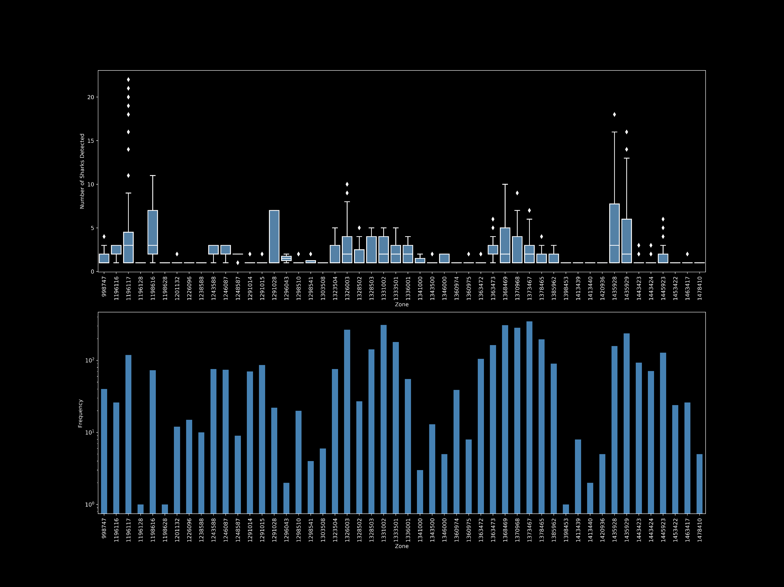
Results: Shark Density v Zone
*Data in this analysis used method 1 for jackknifing
Notes:
In acoustic telemetry, fish are typically fitted with acoustic transmitter that emit a sound wave that is picked up by underwater acoustic receivers. The receiver records the date, time, and tagID of the individual that was within its detection range.
The transmitters used for this study were Vemco V9 transmitters. they randomly send out a signal every 100 to 180 seconds, have a battery life of about one year, and a nominal detection distance of about 500 m.

Slide 18
Results and Discussion: Shark Density v Zone
*Data in this analysis used method 1 for jackknifing
Ordinary Least Squares ANOVA
Shark Density across zones
~ 8 zones showed significantly higher shark densities than others
Zones corresponded to regions in: Santa Barbara, Santa Monica Bay, Long Beach, and Dana Point
May indicate ‘hotspot’ areas that juvenile white sharks use repeatedly
Notes:
In acoustic telemetry, fish are typically fitted with acoustic transmitter that emit a sound wave that is picked up by underwater acoustic receivers. The receiver records the date, time, and tagID of the individual that was within its detection range.
The transmitters used for this study were Vemco V9 transmitters. they randomly send out a signal every 100 to 180 seconds, have a battery life of about one year, and a nominal detection distance of about 500 m.

Slide 19
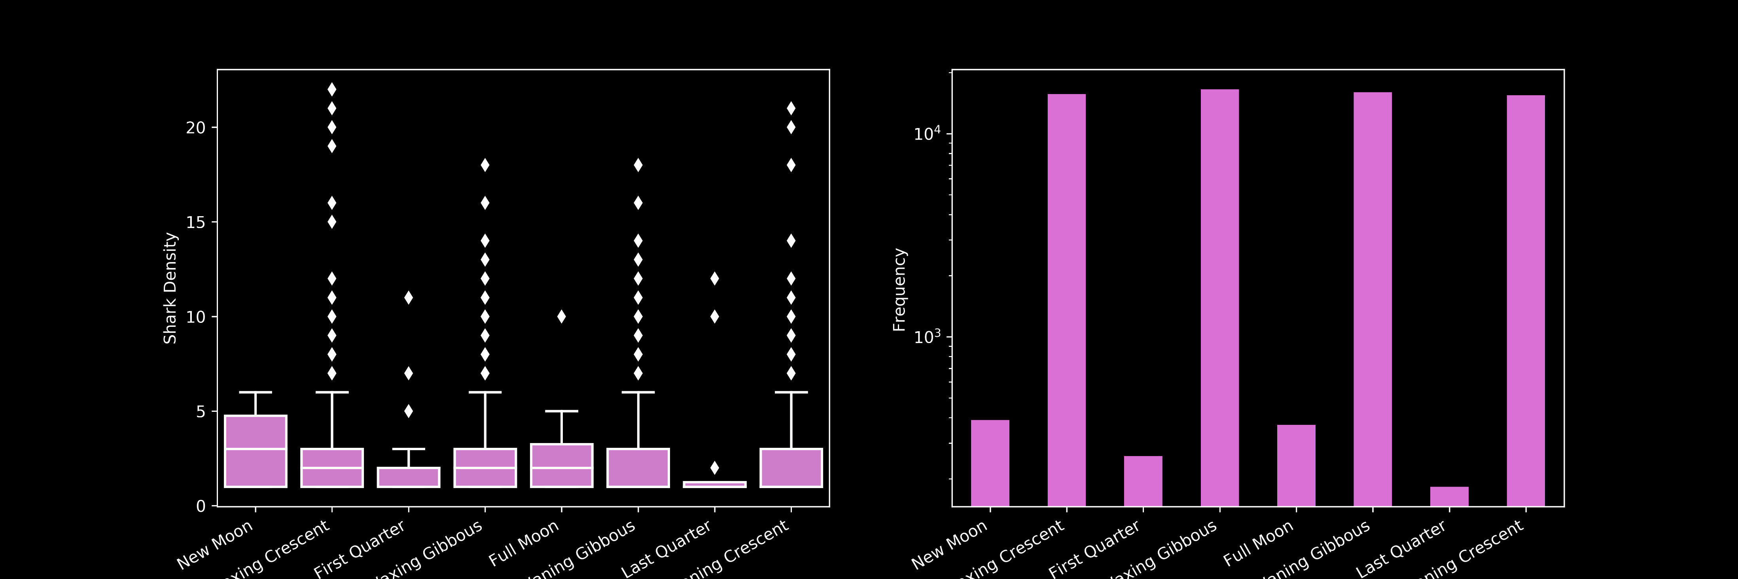
Results: Shark Density v Lunar Phase
*Data in this analysis used method 1 for jackknifing
Ordinary Least Squares ANOVA
Shark Density across lunar phases
No significant difference (p > 0.05)
Notes:
In acoustic telemetry, fish are typically fitted with acoustic transmitter that emit a sound wave that is picked up by underwater acoustic receivers. The receiver records the date, time, and tagID of the individual that was within its detection range.
The transmitters used for this study were Vemco V9 transmitters. they randomly send out a signal every 100 to 180 seconds, have a battery life of about one year, and a nominal detection distance of about 500 m.

Slide 20
Discussion: Shark Density v Lunar Phase
*Data in this analysis used method 1 for jackknifing
No significant difference (p > 0.05)
Juvenile White Shark movements are not driven by the lunar cycle
Notes:
In acoustic telemetry, fish are typically fitted with acoustic transmitter that emit a sound wave that is picked up by underwater acoustic receivers. The receiver records the date, time, and tagID of the individual that was within its detection range.
The transmitters used for this study were Vemco V9 transmitters. they randomly send out a signal every 100 to 180 seconds, have a battery life of about one year, and a nominal detection distance of about 500 m.

Slide 21
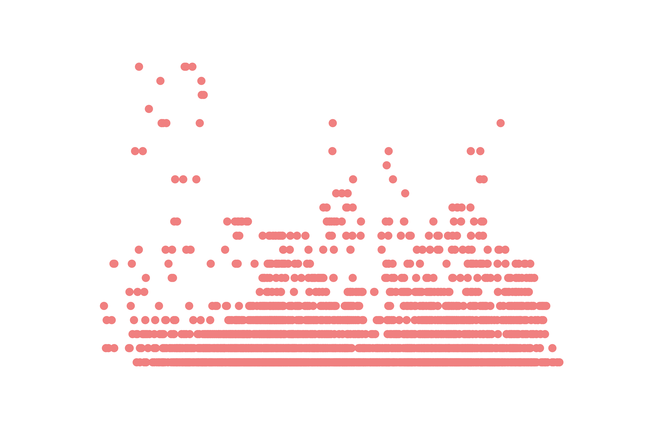
Results: Shark Density v Sea Surface Temperature
*Data in this analysis used method 1 for jackknifing
Min: 10.99
Max: 25
Median: 17.88
STD: 2.66
Highly variable shark densities at all temperature values
Notes:
In acoustic telemetry, fish are typically fitted with acoustic transmitter that emit a sound wave that is picked up by underwater acoustic receivers. The receiver records the date, time, and tagID of the individual that was within its detection range.
The transmitters used for this study were Vemco V9 transmitters. they randomly send out a signal every 100 to 180 seconds, have a battery life of about one year, and a nominal detection distance of about 500 m.

Slide 22

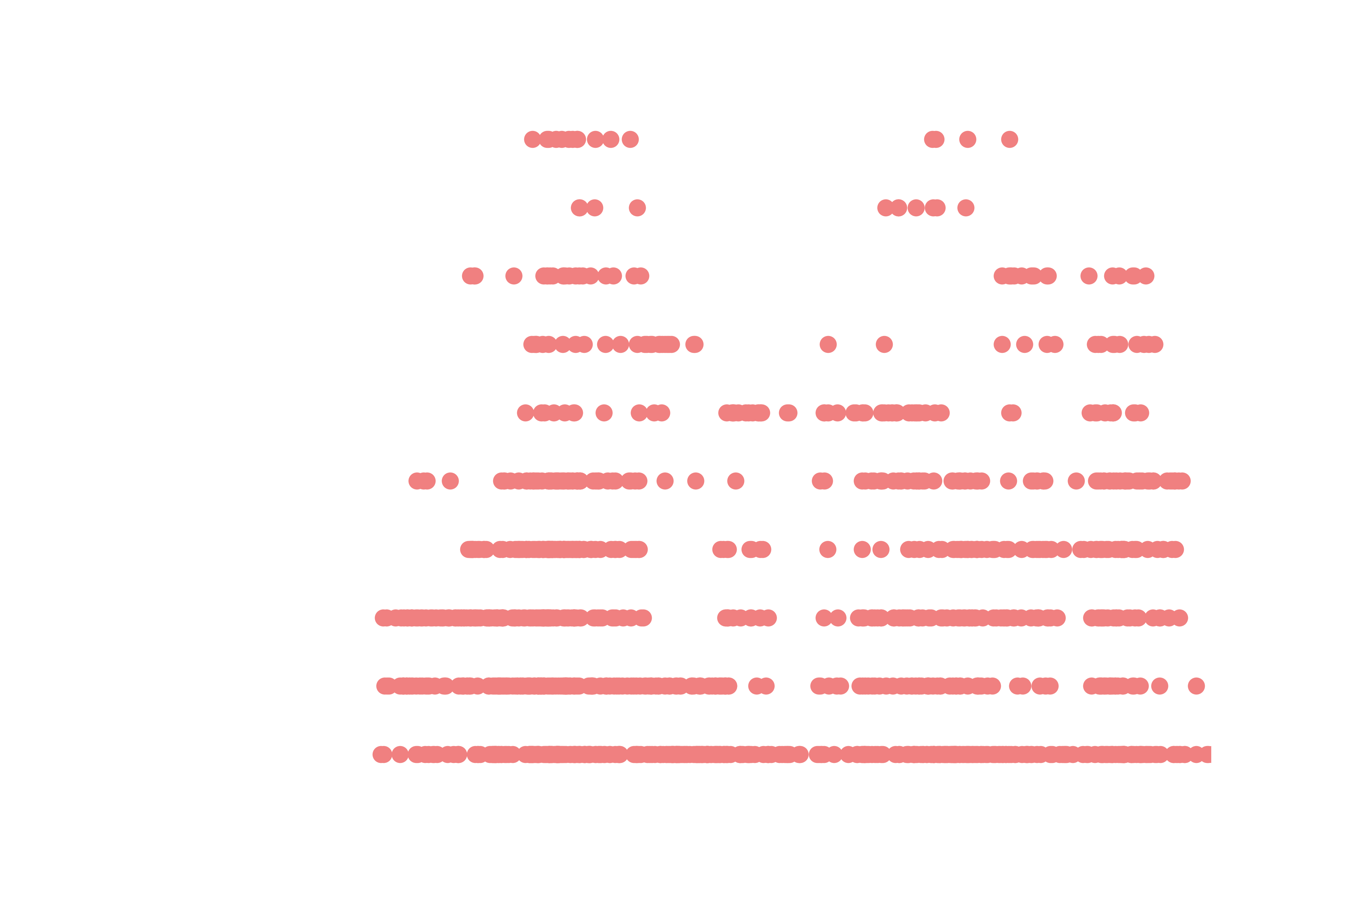

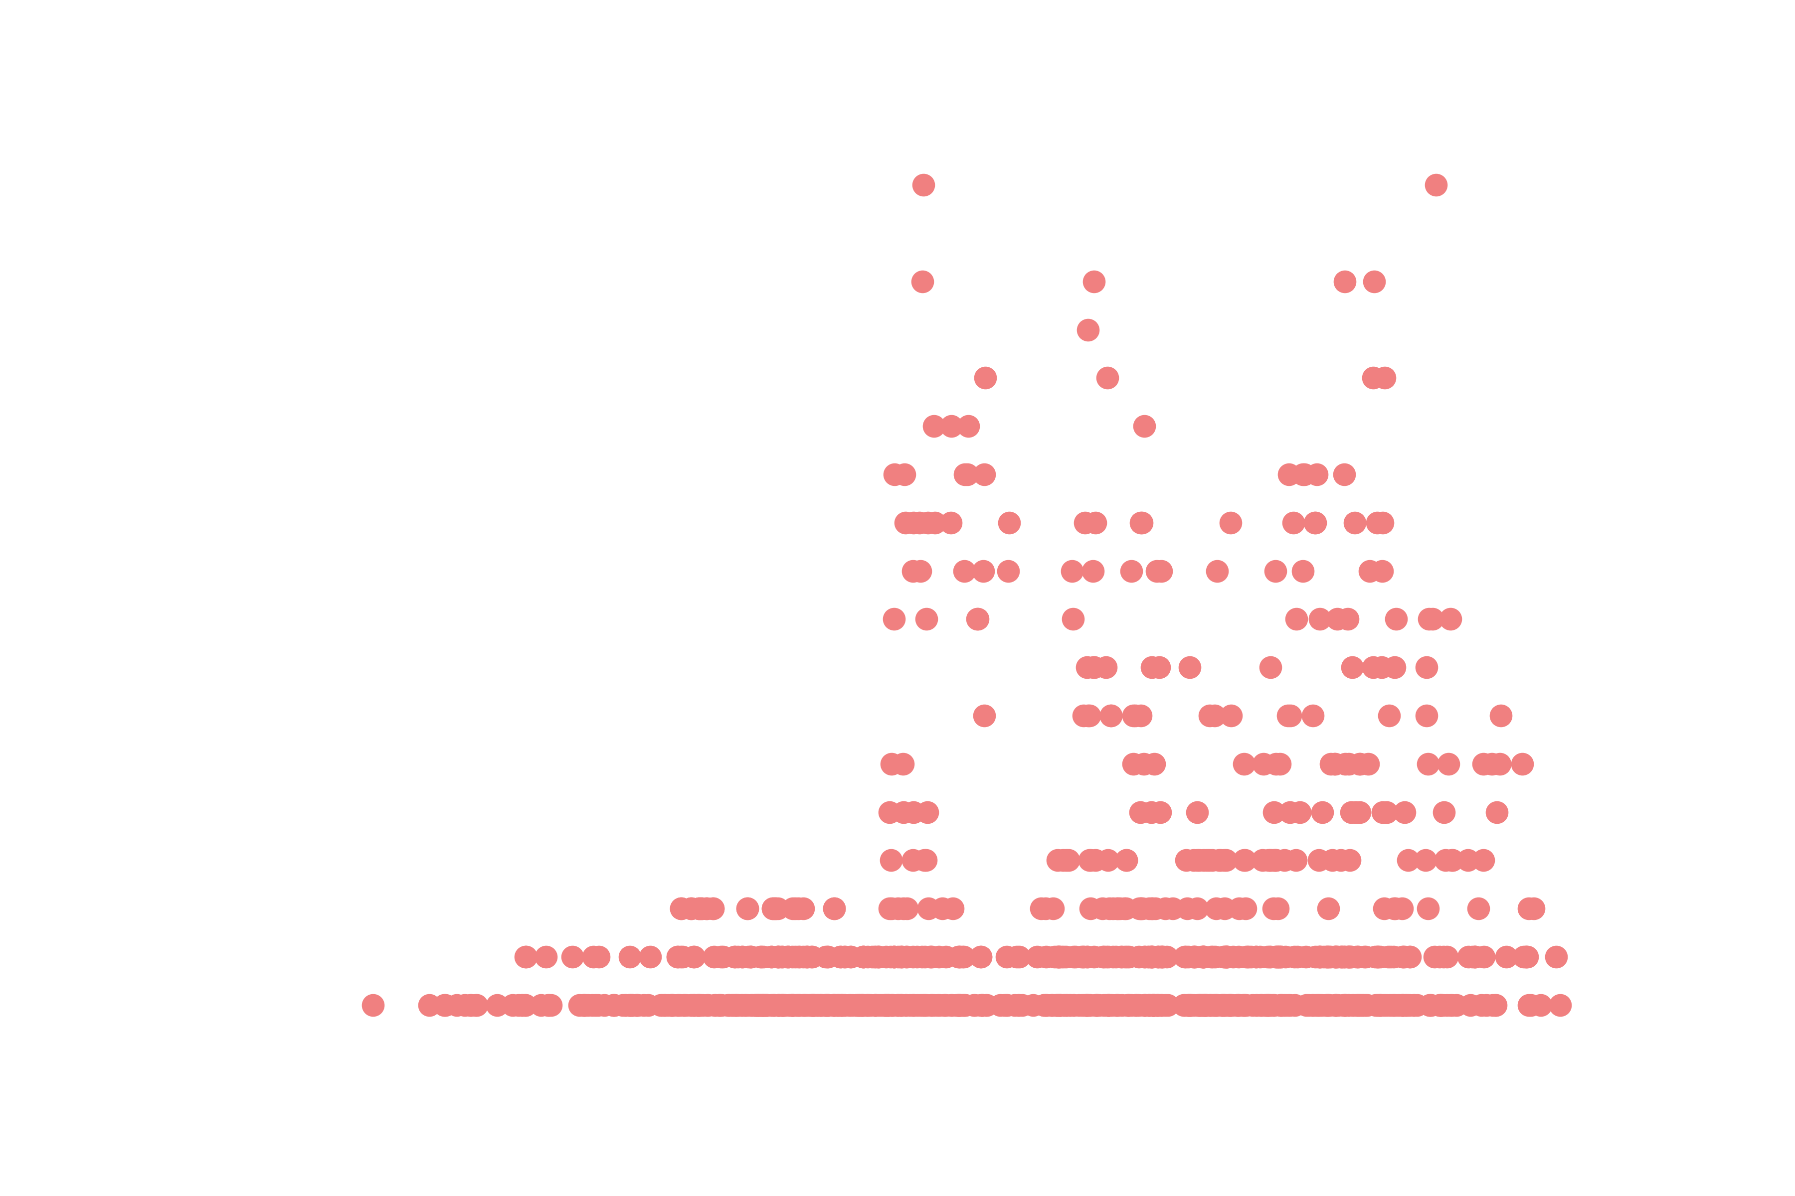
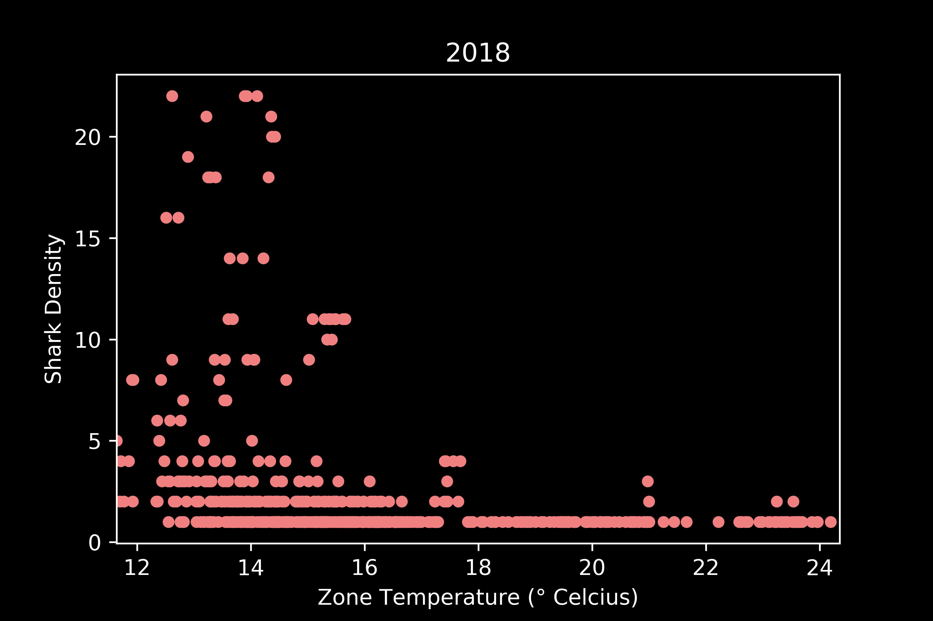

Results: Shark Density v Sea Surface Temperature
2014: 16-17ºC 2015: 16-17ºC, 20-22ºC 2016: 14-18ºC
Different years show different relationships between SST and shark density.
2017: 18-22ºC 2018: 12-14ºC 2019: 13-14ºC
*Data in this analysis used method 1 for jackknifing
Notes:
In acoustic telemetry, fish are typically fitted with acoustic transmitter that emit a sound wave that is picked up by underwater acoustic receivers. The receiver records the date, time, and tagID of the individual that was within its detection range.
The transmitters used for this study were Vemco V9 transmitters. they randomly send out a signal every 100 to 180 seconds, have a battery life of about one year, and a nominal detection distance of about 500 m.

Slide 23

Results: Shark Presence v Sea Surface Temperature
*Data in this analysis used method 1 for jackknifing
Mean (± SD): 18.39 ± 2.65°C
8.31 ± 2.81°C
No significant difference (t = -1.824, p = 0.068)
Notes:
In acoustic telemetry, fish are typically fitted with acoustic transmitter that emit a sound wave that is picked up by underwater acoustic receivers. The receiver records the date, time, and tagID of the individual that was within its detection range.
The transmitters used for this study were Vemco V9 transmitters. they randomly send out a signal every 100 to 180 seconds, have a battery life of about one year, and a nominal detection distance of about 500 m.

Slide 24
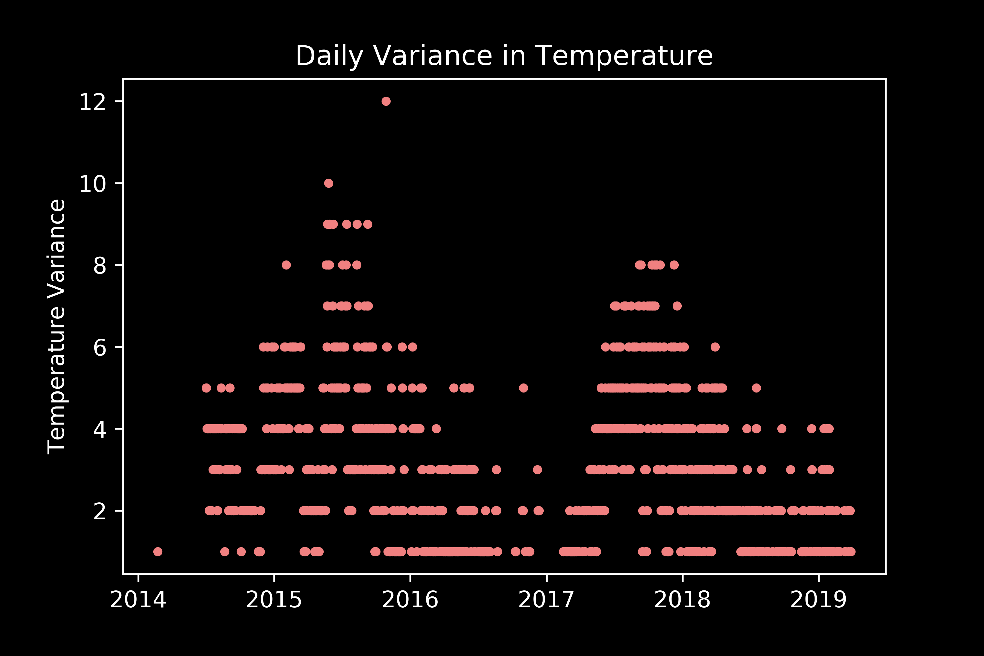
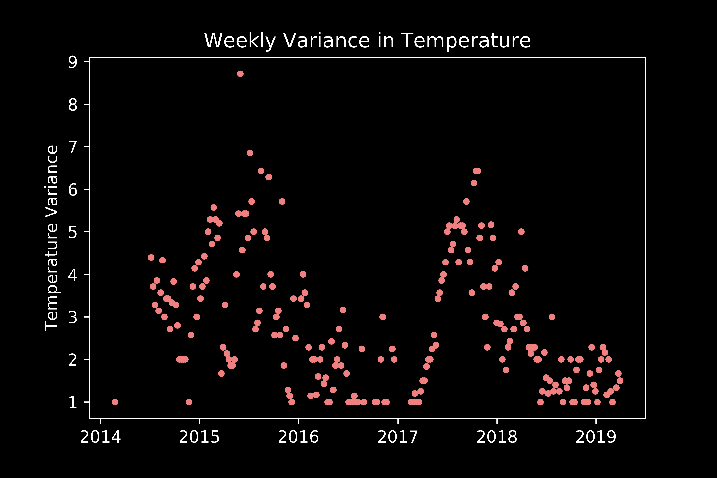
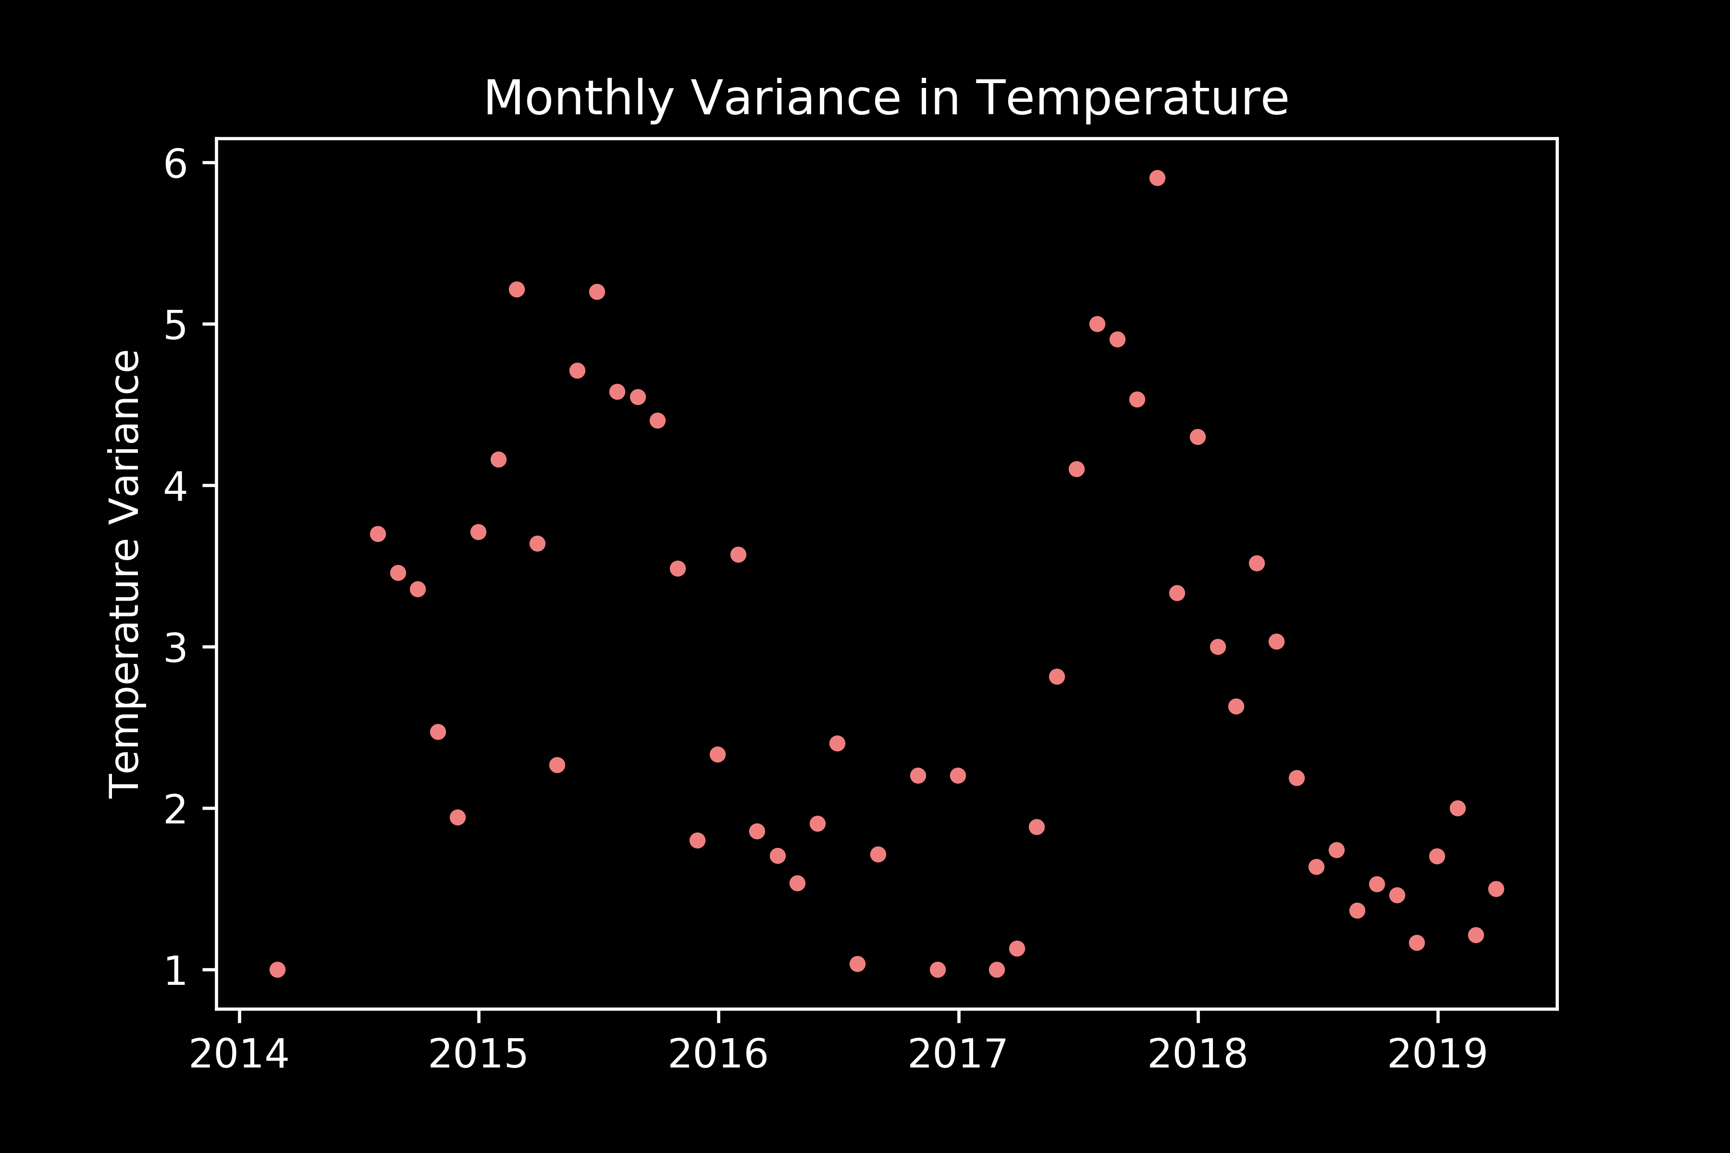
Results: Shark Presence v Sea Surface Temperature
Trends in variance dissolve at the monthly scale
*Data in this analysis used method 1 for jackknifing
Notes:
In acoustic telemetry, fish are typically fitted with acoustic transmitter that emit a sound wave that is picked up by underwater acoustic receivers. The receiver records the date, time, and tagID of the individual that was within its detection range.
The transmitters used for this study were Vemco V9 transmitters. they randomly send out a signal every 100 to 180 seconds, have a battery life of about one year, and a nominal detection distance of about 500 m.

Slide 25

Results: Shark Density v Sea Surface Salinity
*Data in this analysis used method 1 for jackknifing
Min: 30.00
Max: 39.44
Median: 33.27
STD: 1.34
Highly variable shark densities at all salinity values
Notes:
In acoustic telemetry, fish are typically fitted with acoustic transmitter that emit a sound wave that is picked up by underwater acoustic receivers. The receiver records the date, time, and tagID of the individual that was within its detection range.
The transmitters used for this study were Vemco V9 transmitters. they randomly send out a signal every 100 to 180 seconds, have a battery life of about one year, and a nominal detection distance of about 500 m.

Slide 26

Results: Shark Presence v Sea Surface Salinity
*Data in this analysis used method 1 for jackknifing
Mean (± SD): 33.29 ± 1.34 psu
33.29 ± 1.27 psu
No significant difference (t = 0.199, p = 0.842)
Notes:
In acoustic telemetry, fish are typically fitted with acoustic transmitter that emit a sound wave that is picked up by underwater acoustic receivers. The receiver records the date, time, and tagID of the individual that was within its detection range.
The transmitters used for this study were Vemco V9 transmitters. they randomly send out a signal every 100 to 180 seconds, have a battery life of about one year, and a nominal detection distance of about 500 m.

Slide 27



Results: Shark Presence v Sea Surface Salinity
No clear trends in variance at any time scale
*Data in this analysis used method 1 for jackknifing
Notes:
In acoustic telemetry, fish are typically fitted with acoustic transmitter that emit a sound wave that is picked up by underwater acoustic receivers. The receiver records the date, time, and tagID of the individual that was within its detection range.
The transmitters used for this study were Vemco V9 transmitters. they randomly send out a signal every 100 to 180 seconds, have a battery life of about one year, and a nominal detection distance of about 500 m.

Slide 28
Results: Shark Density v Chlorophyll-A
*Data in this analysis used method 1 for jackknifing
Min: 2.27e-14
Max: 359.25
Median: 0.32
STD: 7.38
Highly variable shark densities at chlorophyll values < 50
Notes:
In acoustic telemetry, fish are typically fitted with acoustic transmitter that emit a sound wave that is picked up by underwater acoustic receivers. The receiver records the date, time, and tagID of the individual that was within its detection range.
The transmitters used for this study were Vemco V9 transmitters. they randomly send out a signal every 100 to 180 seconds, have a battery life of about one year, and a nominal detection distance of about 500 m.

Slide 29
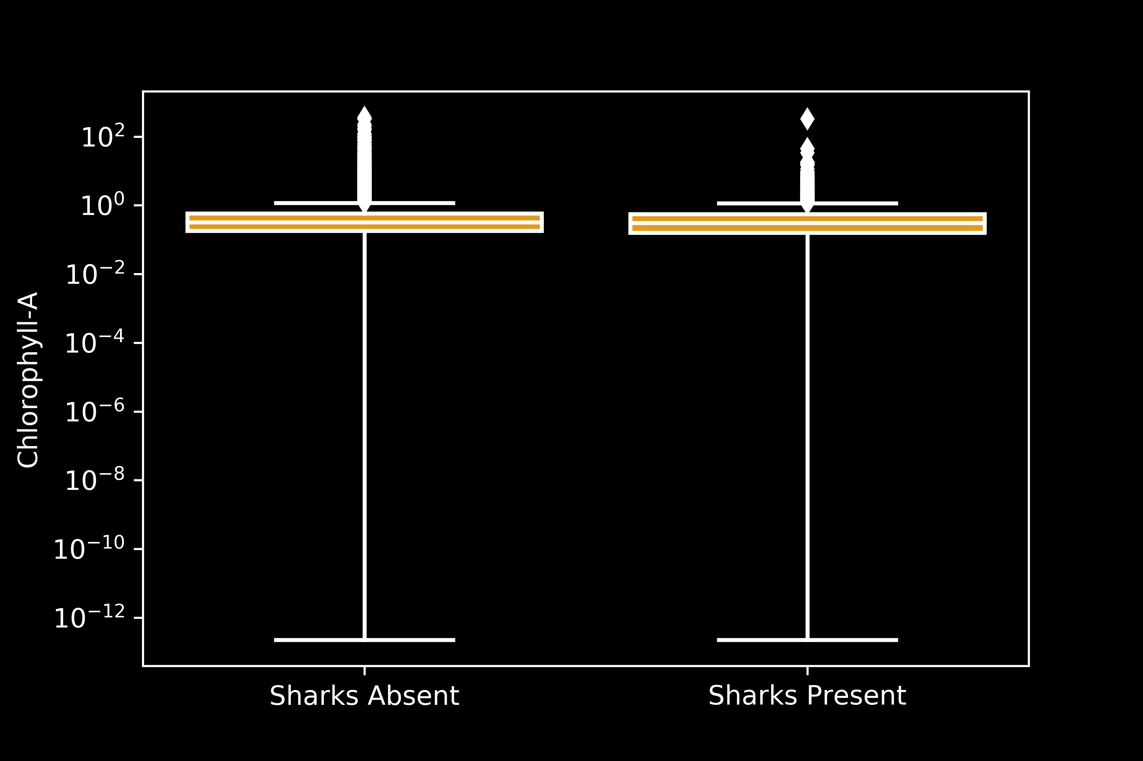
Results: Shark Presence v Chlorophyll-A
*Data in this analysis used method 1 for jackknifing
Mean (± SD): 0.86 ± 7.50 mg/m³
0.72 ± 5.46 mg/m³
No significant difference (t = -1.119, p = 0.263)
Notes:
In acoustic telemetry, fish are typically fitted with acoustic transmitter that emit a sound wave that is picked up by underwater acoustic receivers. The receiver records the date, time, and tagID of the individual that was within its detection range.
The transmitters used for this study were Vemco V9 transmitters. they randomly send out a signal every 100 to 180 seconds, have a battery life of about one year, and a nominal detection distance of about 500 m.

Slide 30
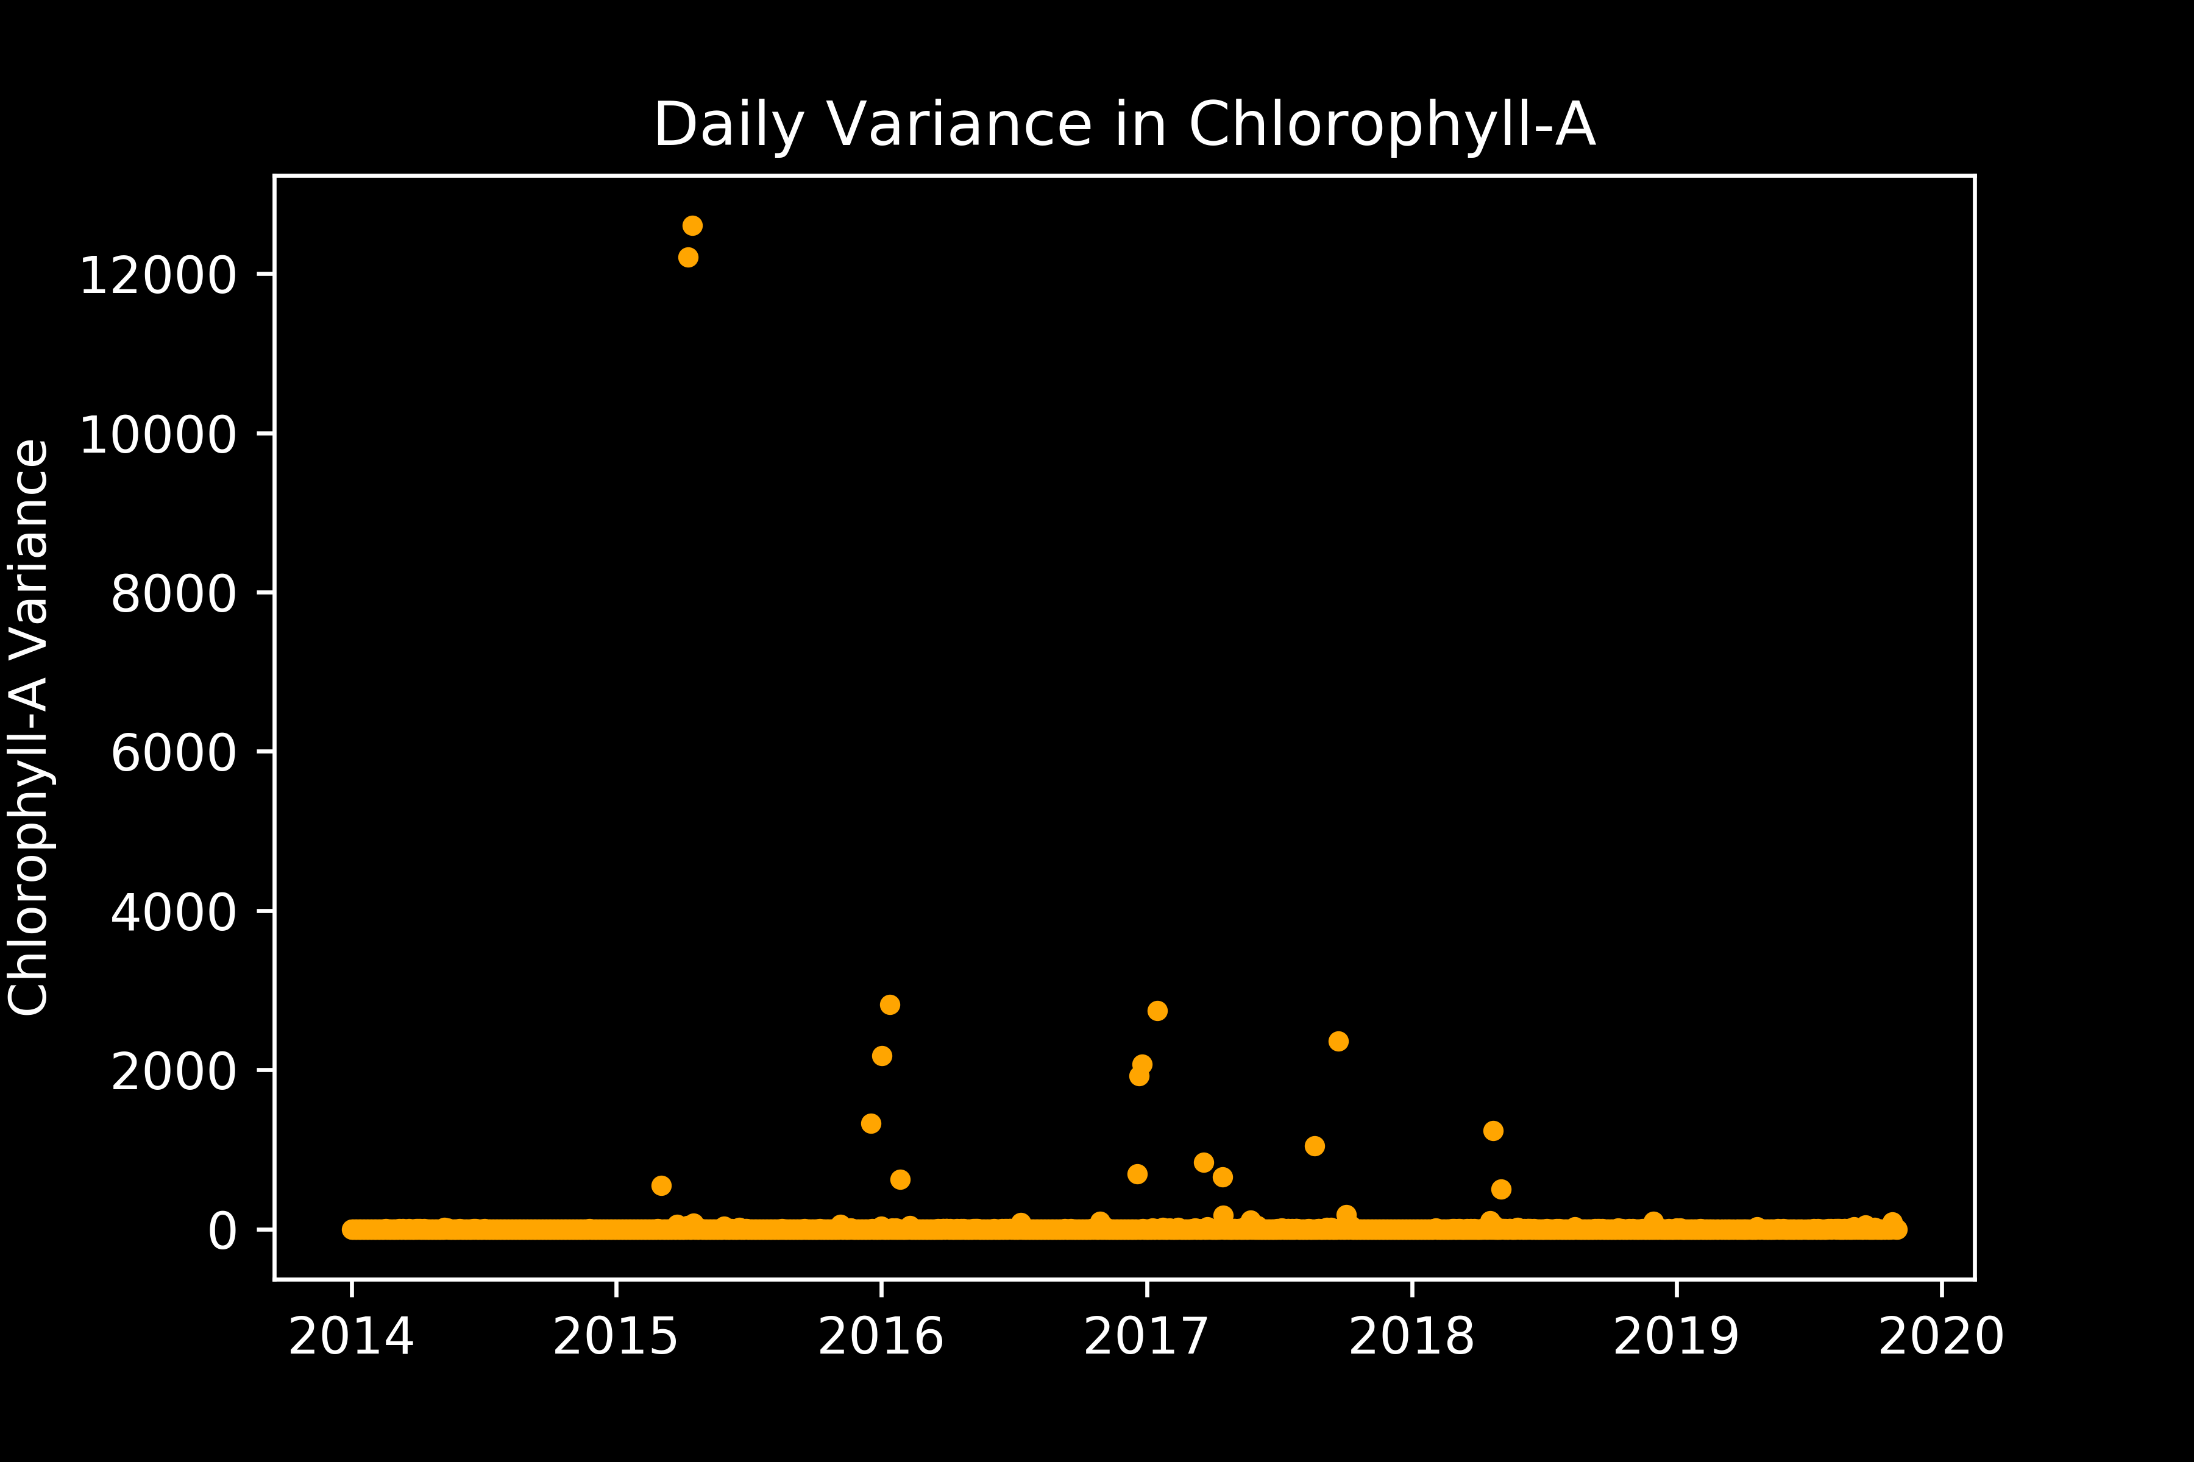
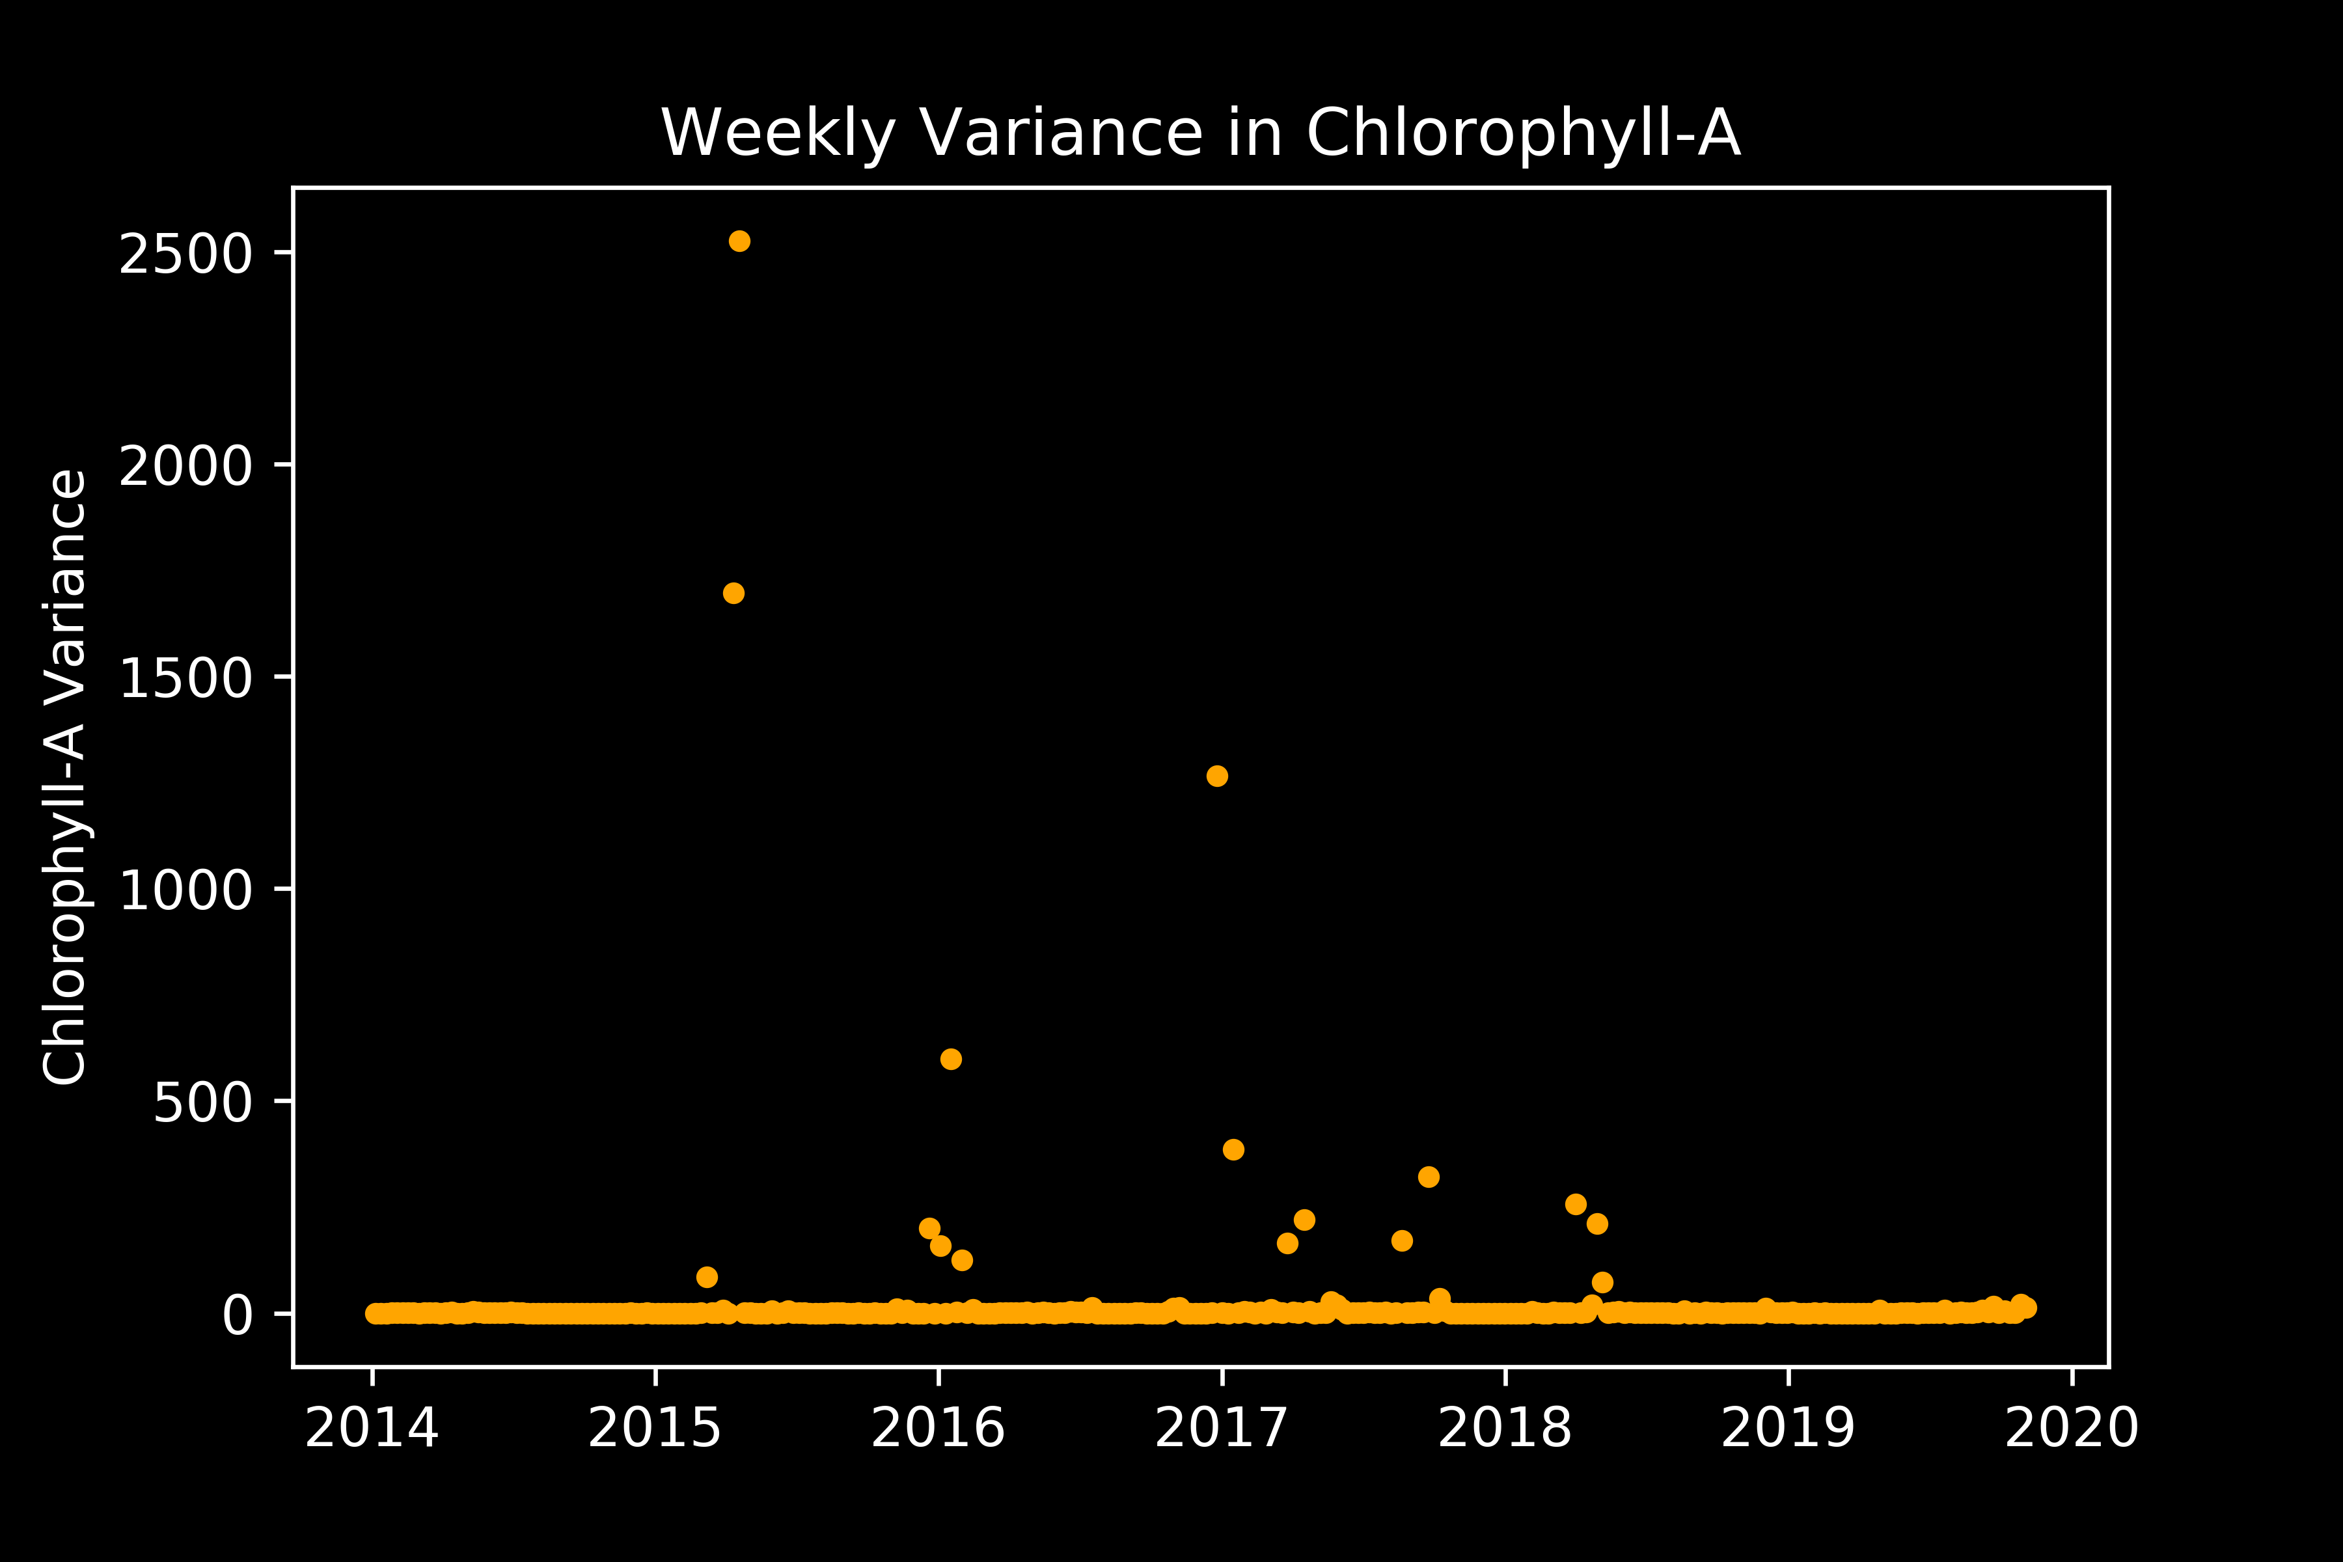
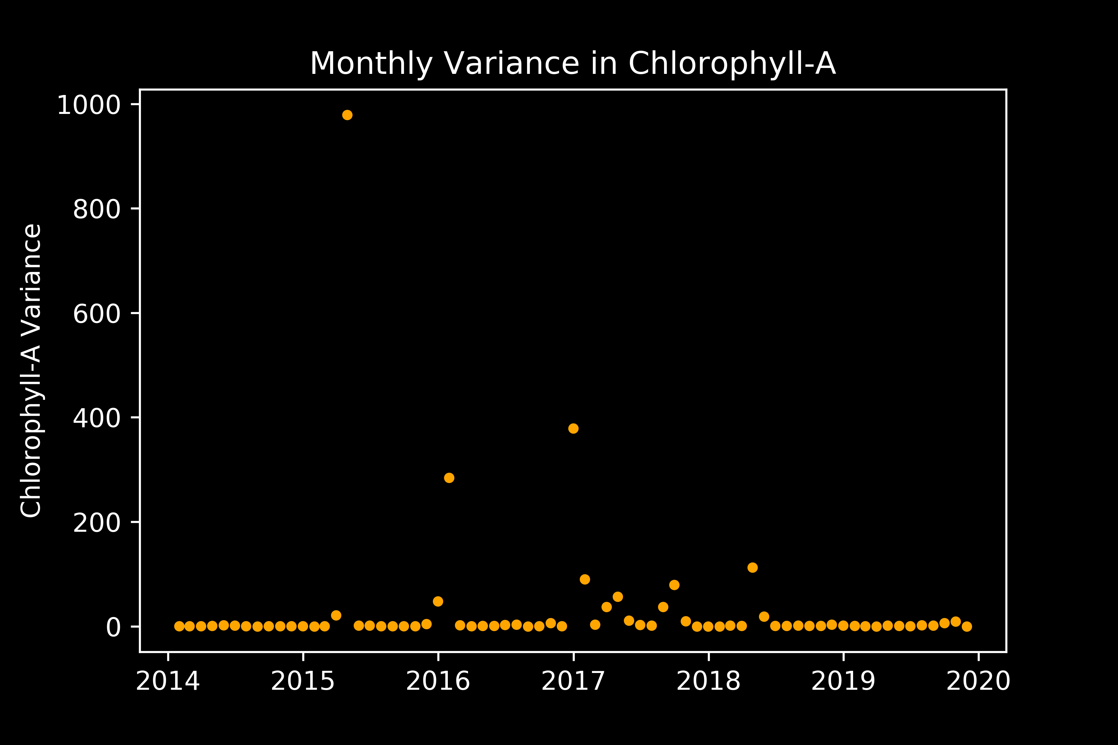
Results: Shark Presence v Chlorophyll-A
No clear trends in variance at any time scale
*Data in this analysis used method 1 for jackknifing
Notes:
In acoustic telemetry, fish are typically fitted with acoustic transmitter that emit a sound wave that is picked up by underwater acoustic receivers. The receiver records the date, time, and tagID of the individual that was within its detection range.
The transmitters used for this study were Vemco V9 transmitters. they randomly send out a signal every 100 to 180 seconds, have a battery life of about one year, and a nominal detection distance of about 500 m.

Slide 31
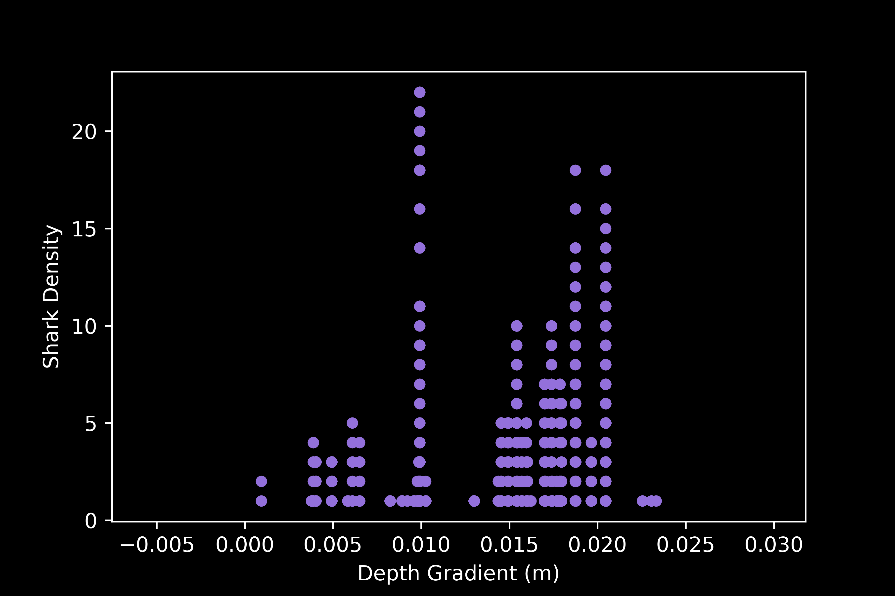
Results: Shark Density v Seafloor Depth Gradient
*Data in this analysis used method 1 for jackknifing
Min: 0.0009
Max: 0.023
Median: 0.007
STD: 0.005
Highly variable shark densities most gradient values
Notes:
In acoustic telemetry, fish are typically fitted with acoustic transmitter that emit a sound wave that is picked up by underwater acoustic receivers. The receiver records the date, time, and tagID of the individual that was within its detection range.
The transmitters used for this study were Vemco V9 transmitters. they randomly send out a signal every 100 to 180 seconds, have a battery life of about one year, and a nominal detection distance of about 500 m.

Slide 32

Results: Shark Presence v Depth Gradient
*Data in this analysis used method 1 for jackknifing
Mean (± SD): 0.009 ± 0.005 m
0.015 ± 0.004 m
Significant difference (t = 84.668, p < 0.01)
Notes:
In acoustic telemetry, fish are typically fitted with acoustic transmitter that emit a sound wave that is picked up by underwater acoustic receivers. The receiver records the date, time, and tagID of the individual that was within its detection range.
The transmitters used for this study were Vemco V9 transmitters. they randomly send out a signal every 100 to 180 seconds, have a battery life of about one year, and a nominal detection distance of about 500 m.

Slide 33
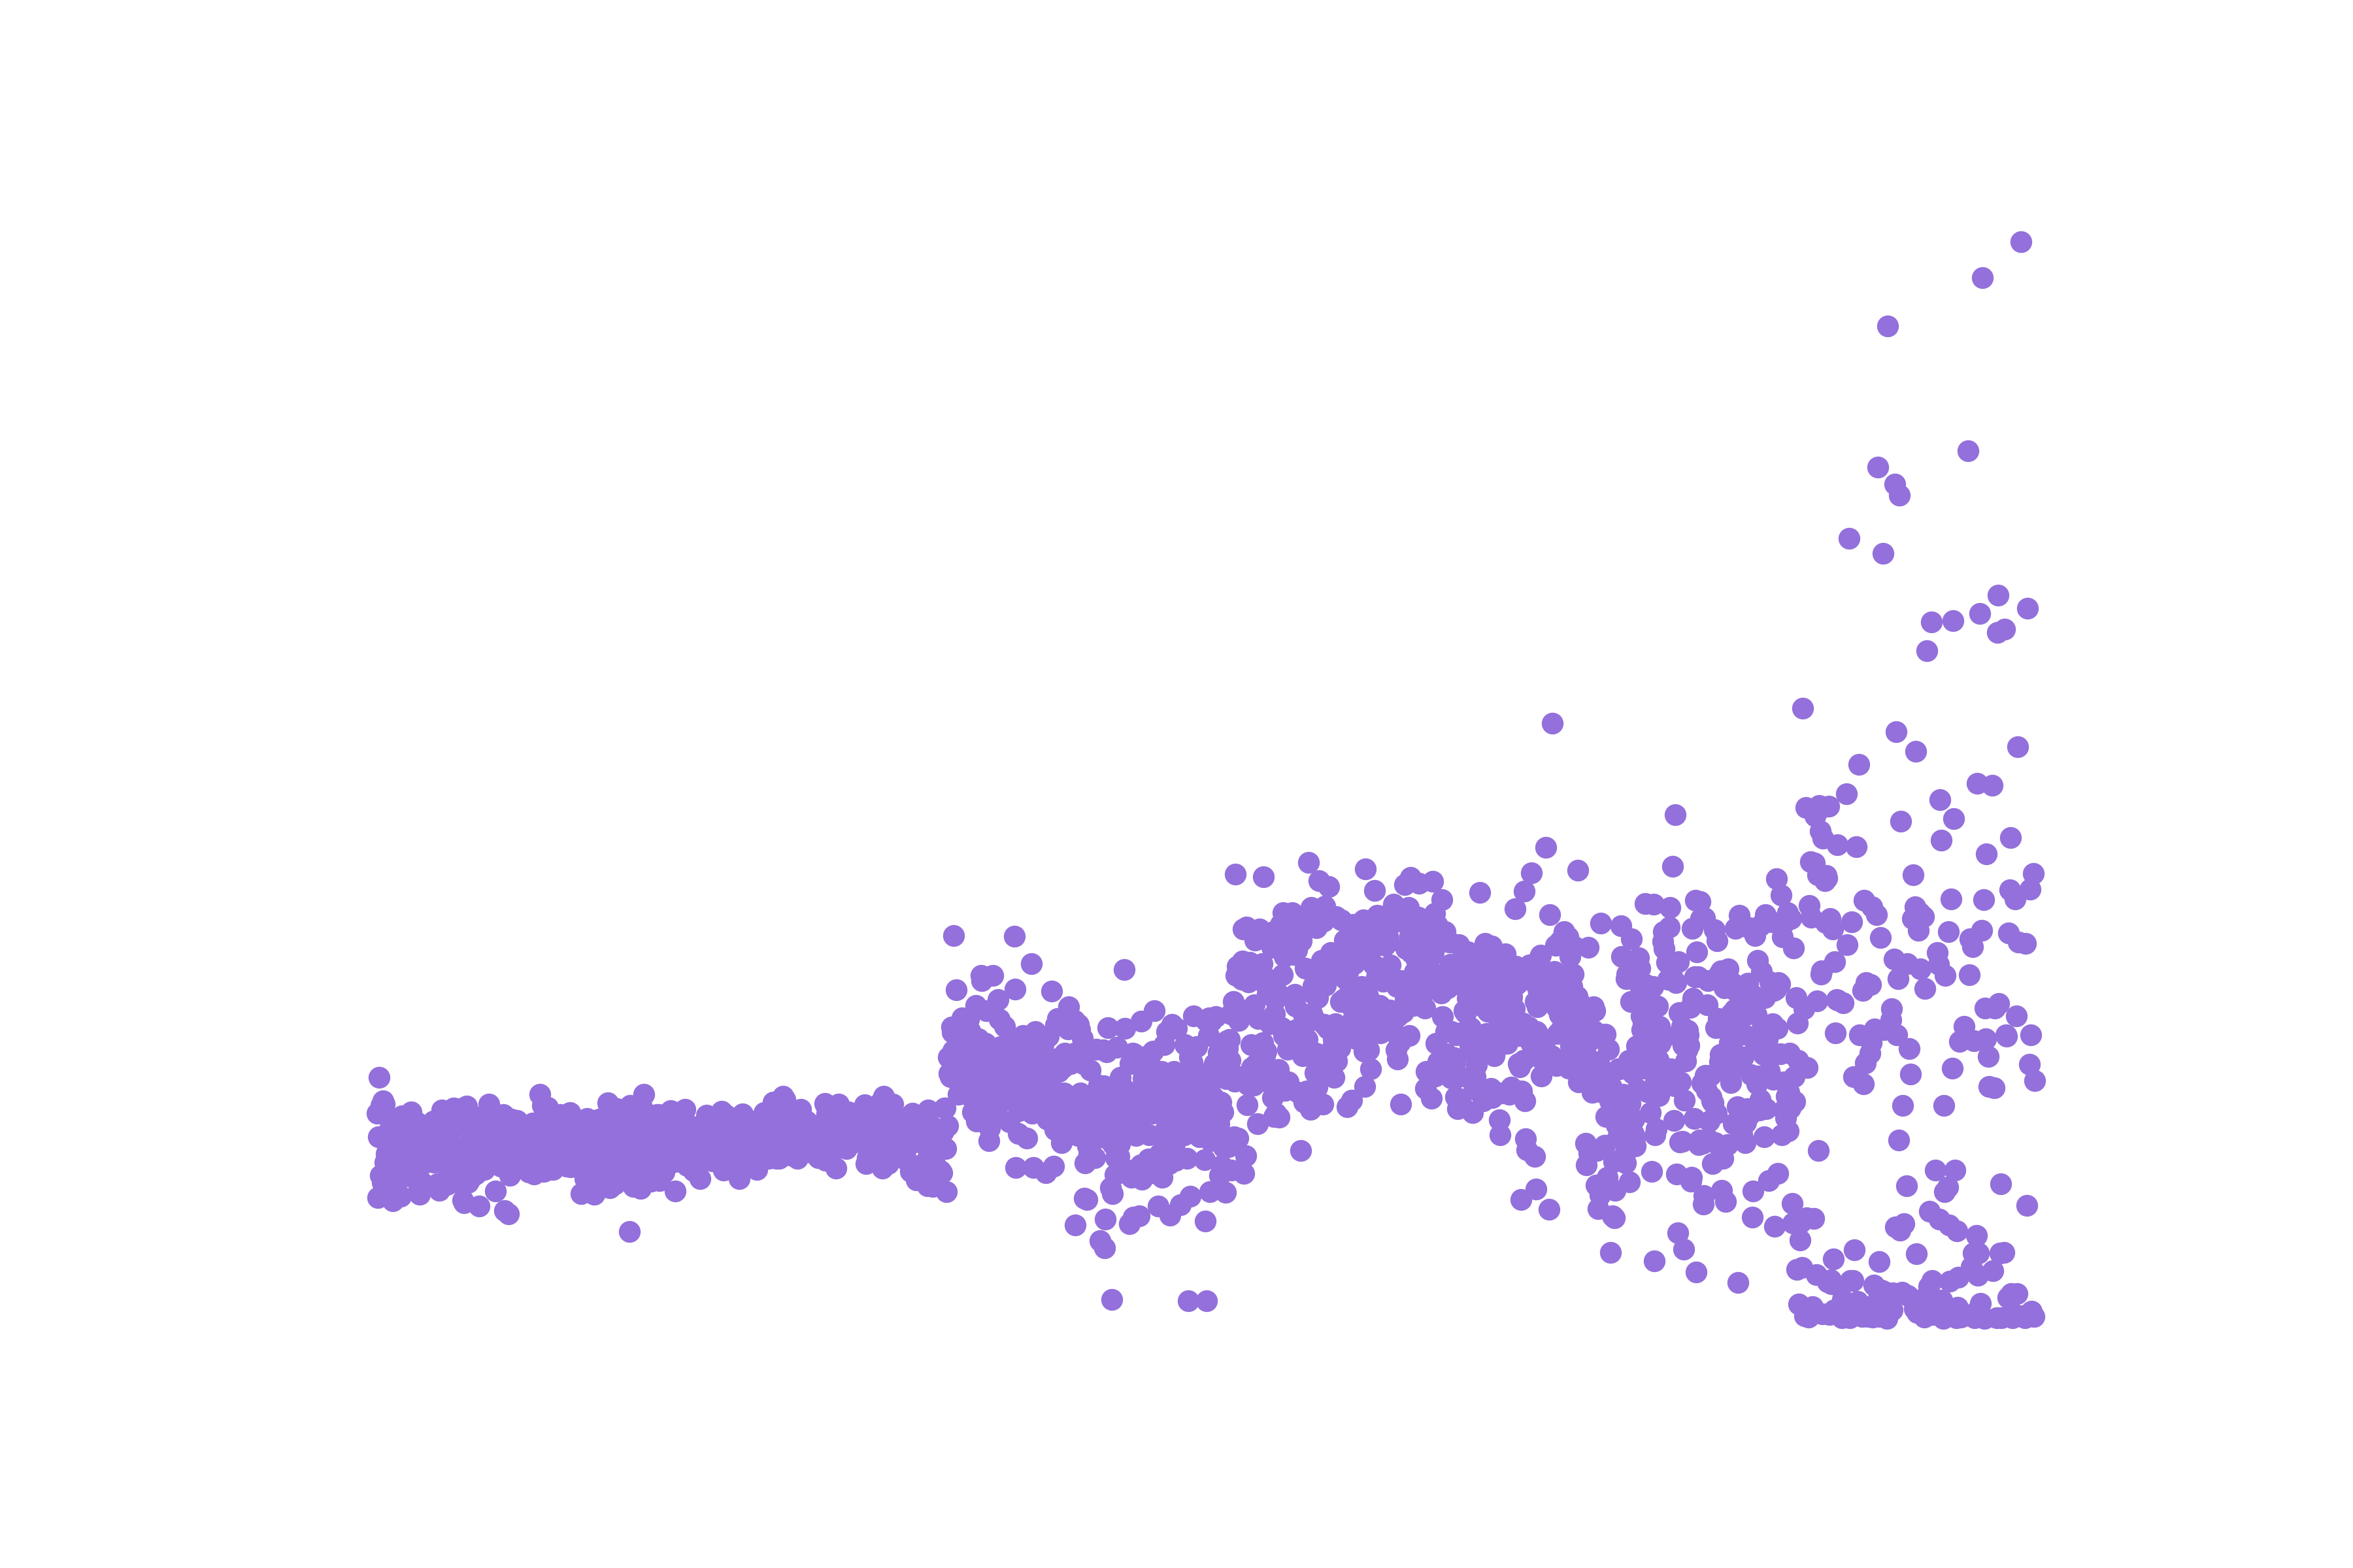
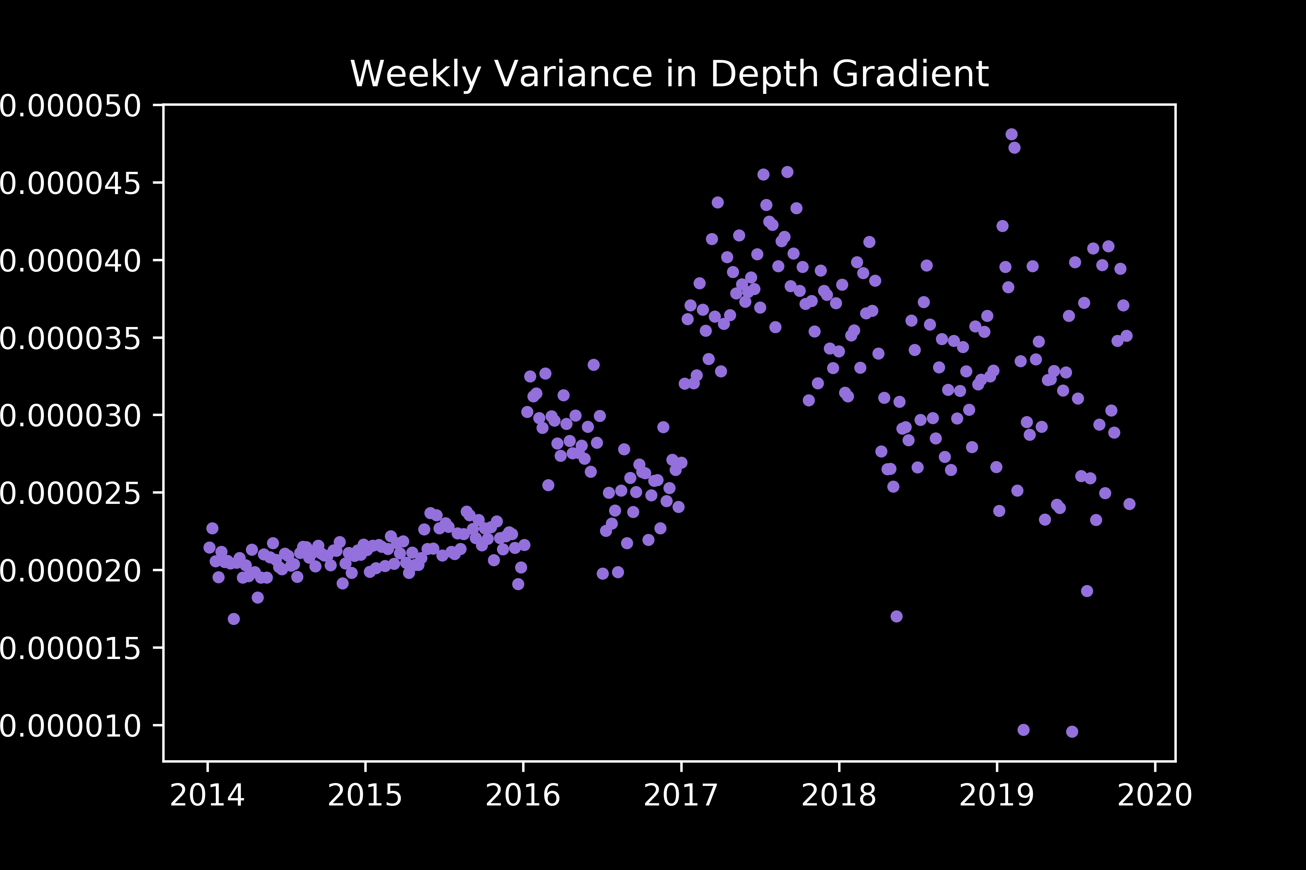
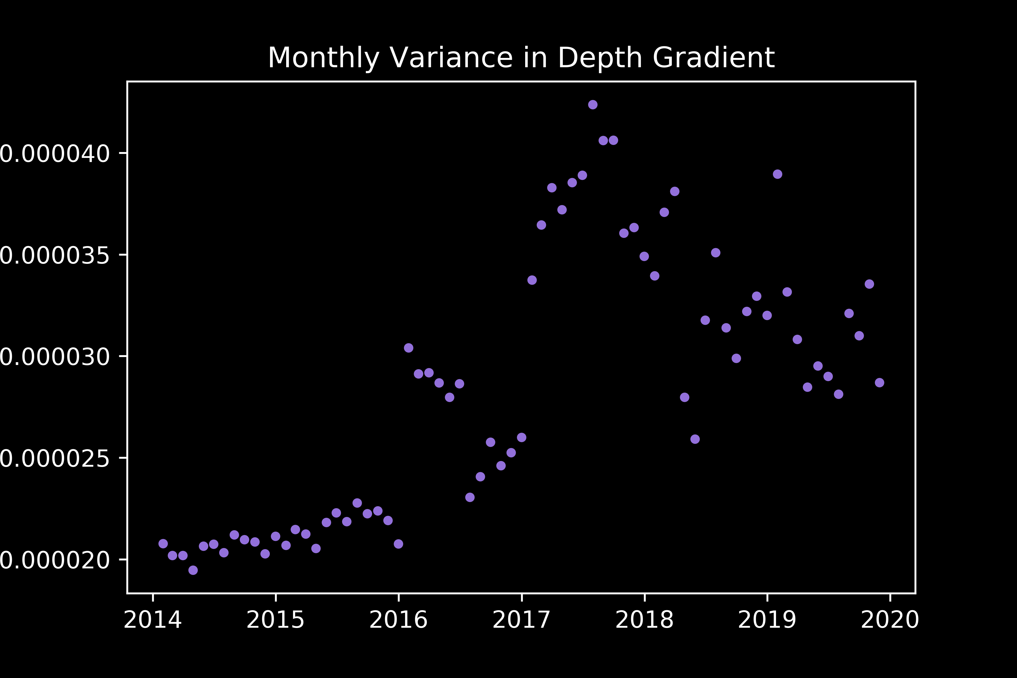
Results: Shark Presence v Depth Gradient
Increasing variance in recent years on all scales
→ More receiver coverage in steeper regions
*Data in this analysis used method 1 for jackknifing
Notes:
In acoustic telemetry, fish are typically fitted with acoustic transmitter that emit a sound wave that is picked up by underwater acoustic receivers. The receiver records the date, time, and tagID of the individual that was within its detection range.
The transmitters used for this study were Vemco V9 transmitters. they randomly send out a signal every 100 to 180 seconds, have a battery life of about one year, and a nominal detection distance of about 500 m.

Slide 34
Methods: Preliminary Machine Learning
*Data in this analysis used method 1 for jackknifing
Data Formatting:
One Hot Encoding using pandas get_dummies()
Zone, Month, Year, Lunar Phase
Data split into training and testing data
Preliminary Machine Learning:
Decision Tree
Gradient Boosting
Stochastic Gradient Descent
K Nearest Neighbors
Gaussian Naïve Bayes
Gaussian Process Classifier
Notes:
In acoustic telemetry, fish are typically fitted with acoustic transmitter that emit a sound wave that is picked up by underwater acoustic receivers. The receiver records the date, time, and tagID of the individual that was within its detection range.
The transmitters used for this study were Vemco V9 transmitters. they randomly send out a signal every 100 to 180 seconds, have a battery life of about one year, and a nominal detection distance of about 500 m.

Slide 35
Results: Preliminary Machine Learning
*Data in this analysis used method 1 for jackknifing
Decision Tree
Tested:
Balanced vs non balanced class weights, range of max depths (grid search and for loop)
Best model (based on accuracy):
Class weights = None, max_depth = 10
Precision = 0.996; Recall = 0.985
Good performance, but hard to interpret after 10 levels.
Notes:
In acoustic telemetry, fish are typically fitted with acoustic transmitter that emit a sound wave that is picked up by underwater acoustic receivers. The receiver records the date, time, and tagID of the individual that was within its detection range.
The transmitters used for this study were Vemco V9 transmitters. they randomly send out a signal every 100 to 180 seconds, have a battery life of about one year, and a nominal detection distance of about 500 m.

Slide 36
Results: Preliminary Machine Learning
*Data in this analysis used method 1 for jackknifing
Gradient Boosting
Tested:
Range of learning rates, max depth, and n estimators (for loop and grid search)
Results:
Learning rate < 0.5 → higher accuracy
Learning rate > 0.5 → lower accuracy
Best model (based on accuracy):
Learning_rate = 0.075, max_depth = 3, n_estimators = 100
Harder to visualize decision splits.
Notes:
In acoustic telemetry, fish are typically fitted with acoustic transmitter that emit a sound wave that is picked up by underwater acoustic receivers. The receiver records the date, time, and tagID of the individual that was within its detection range.
The transmitters used for this study were Vemco V9 transmitters. they randomly send out a signal every 100 to 180 seconds, have a battery life of about one year, and a nominal detection distance of about 500 m.

Slide 37
Results: Preliminary Machine Learning
*Data in this analysis used method 1 for jackknifing
Stochastic Gradient Descent
Tested:
Attempted grid search w/ several parameters
Results:
Model was running for 12+ hours before termination
Model ran with default hyperparameters
Precision = 0.99, Recall = 0.99
Unable to establish hyperparameters but yielded good results
Notes:
In acoustic telemetry, fish are typically fitted with acoustic transmitter that emit a sound wave that is picked up by underwater acoustic receivers. The receiver records the date, time, and tagID of the individual that was within its detection range.
The transmitters used for this study were Vemco V9 transmitters. they randomly send out a signal every 100 to 180 seconds, have a battery life of about one year, and a nominal detection distance of about 500 m.

Slide 38
Results: Preliminary Machine Learning
*Data in this analysis used method 1 for jackknifing
K Nearest Neighbors
Tested:
Nearest Neighbors ranging from 1-30, uniform and distance weighting (for loop)
Results:
Uniform Weighting with 10 nearest neighbors
Testing Precision = 0.991, Recall = 0.991
Distance Weighting with 9 nearest neighbors
Testing Precision = 0.9925, Recall = 0.9945
Unable to describe classification in terms of predictors
Notes:
In acoustic telemetry, fish are typically fitted with acoustic transmitter that emit a sound wave that is picked up by underwater acoustic receivers. The receiver records the date, time, and tagID of the individual that was within its detection range.
The transmitters used for this study were Vemco V9 transmitters. they randomly send out a signal every 100 to 180 seconds, have a battery life of about one year, and a nominal detection distance of about 500 m.

Slide 39
Results: Preliminary Machine Learning
*Data in this analysis used method 1 for jackknifing
Gaussian Naïve Bayes
Tested:
Default hyperparameters
Results:
Testing Precision = 0.9999, Recall = 0.9337
Unable to establish hyperparameters but yielded good results
Notes:
In acoustic telemetry, fish are typically fitted with acoustic transmitter that emit a sound wave that is picked up by underwater acoustic receivers. The receiver records the date, time, and tagID of the individual that was within its detection range.
The transmitters used for this study were Vemco V9 transmitters. they randomly send out a signal every 100 to 180 seconds, have a battery life of about one year, and a nominal detection distance of about 500 m.

Slide 40
Results: Preliminary Machine Learning
*Data in this analysis used method 1 for jackknifing
Gaussian Process
Tested:
Default hyperparameters
Results:
Too large for classifier to handle
Fitted data with subsamples (5000 rows) at a time
Testing Precision = 0.95, Recall = 0.998
Unable to establish hyperparameters but yielded good results
Notes:
In acoustic telemetry, fish are typically fitted with acoustic transmitter that emit a sound wave that is picked up by underwater acoustic receivers. The receiver records the date, time, and tagID of the individual that was within its detection range.
The transmitters used for this study were Vemco V9 transmitters. they randomly send out a signal every 100 to 180 seconds, have a battery life of about one year, and a nominal detection distance of about 500 m.

Slide 41
Methods: Refined Machine Learning
Based on the preliminary machine learning analyses, these results seemed too good to be true.
Hypothesis: Models are automatically classifying regions with receiver densities of 0 to have no sharks
Technically true, but high potential of false negatives.
Response: Re-do jackknifing to only include times when receiver density > 0.
Notes:
In acoustic telemetry, fish are typically fitted with acoustic transmitter that emit a sound wave that is picked up by underwater acoustic receivers. The receiver records the date, time, and tagID of the individual that was within its detection range.
The transmitters used for this study were Vemco V9 transmitters. they randomly send out a signal every 100 to 180 seconds, have a battery life of about one year, and a nominal detection distance of about 500 m.

Slide 42
Methods: Refined Machine Learning
*Data in this analysis used method 2 for jackknifing
Data Formatting:
Jackknife data to only include receiver densities > 0
Manually balance data:
Additional random samples of data when sharks are present (not enough data to down-scale)
One Hot Encoding using pandas get_dummies()
Zone, Month, Year, Lunar Phase
Data split into training and testing data
Machine Learning Algorithms
Decision Tree
Gradient Boosting
K Nearest Neighbors
Notes:
In acoustic telemetry, fish are typically fitted with acoustic transmitter that emit a sound wave that is picked up by underwater acoustic receivers. The receiver records the date, time, and tagID of the individual that was within its detection range.
The transmitters used for this study were Vemco V9 transmitters. they randomly send out a signal every 100 to 180 seconds, have a battery life of about one year, and a nominal detection distance of about 500 m.

Slide 43
Results: Refined Machine Learning
*Data in this analysis used method 2 for jackknifing
Decision Tree
Tested:
Max depth between 3 and 10 (grid search)
Best model (based on precision):
Max depth = 10
But all models showed precision between 0.65 and 0.85
Notes:
In acoustic telemetry, fish are typically fitted with acoustic transmitter that emit a sound wave that is picked up by underwater acoustic receivers. The receiver records the date, time, and tagID of the individual that was within its detection range.
The transmitters used for this study were Vemco V9 transmitters. they randomly send out a signal every 100 to 180 seconds, have a battery life of about one year, and a nominal detection distance of about 500 m.

Slide 44
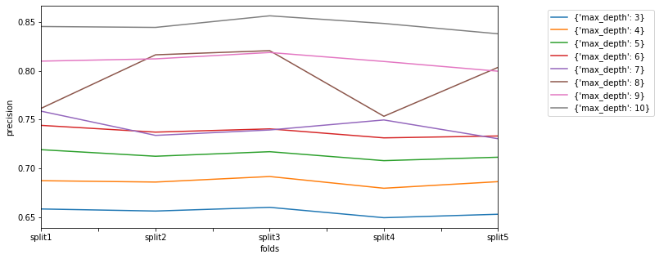
Results: Refined Machine Learning
*Data in this analysis used method 2 for jackknifing
Decision Tree
All models showed precision between 0.65 - 0.85
Max_depth = 6 → Easier to interpret
Training data precision = 0.928
Testing data precision = 0.931
Notes:
In acoustic telemetry, fish are typically fitted with acoustic transmitter that emit a sound wave that is picked up by underwater acoustic receivers. The receiver records the date, time, and tagID of the individual that was within its detection range.
The transmitters used for this study were Vemco V9 transmitters. they randomly send out a signal every 100 to 180 seconds, have a battery life of about one year, and a nominal detection distance of about 500 m.

Slide 45
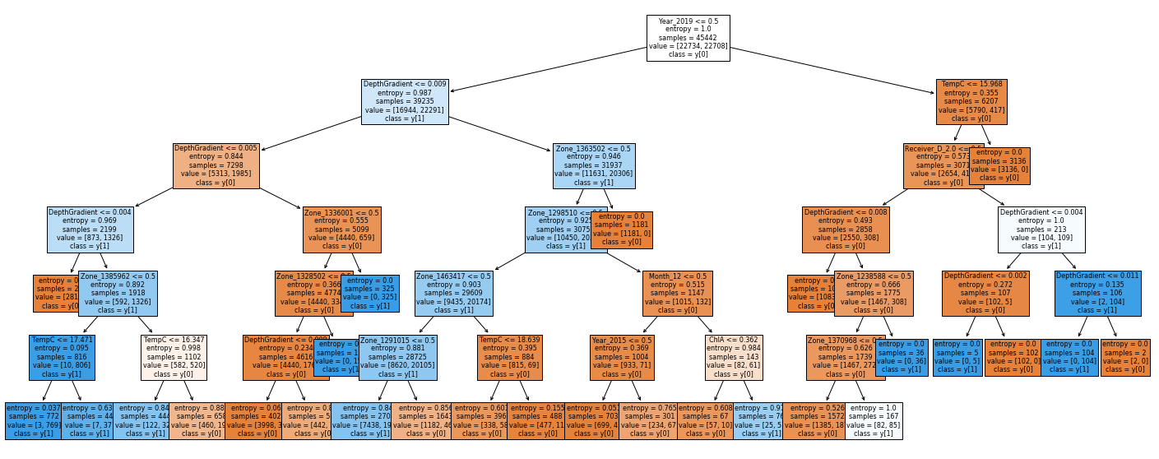
Results: Refined Machine Learning
*Data in this analysis used method 2 for jackknifing
Decision Tree
Max_depth = 6 → Easier to interpret
Most important parameters:
Depth gradient; year 2019; receiver density = 2, temperature, particular zones
Notes:
In acoustic telemetry, fish are typically fitted with acoustic transmitter that emit a sound wave that is picked up by underwater acoustic receivers. The receiver records the date, time, and tagID of the individual that was within its detection range.
The transmitters used for this study were Vemco V9 transmitters. they randomly send out a signal every 100 to 180 seconds, have a battery life of about one year, and a nominal detection distance of about 500 m.

Slide 46
Results: Refined Machine Learning
*Data in this analysis used method 2 for jackknifing
Gradient Boosting
Tested:
Learning rate, max depth, n estimators (grid search)
Best model (based on precision):
Learning_rate = 0.75, max_depth = 8, n_estimators = 100
But all models showed precision between 0.65 and 0.99
Notes:
In acoustic telemetry, fish are typically fitted with acoustic transmitter that emit a sound wave that is picked up by underwater acoustic receivers. The receiver records the date, time, and tagID of the individual that was within its detection range.
The transmitters used for this study were Vemco V9 transmitters. they randomly send out a signal every 100 to 180 seconds, have a battery life of about one year, and a nominal detection distance of about 500 m.

Slide 47
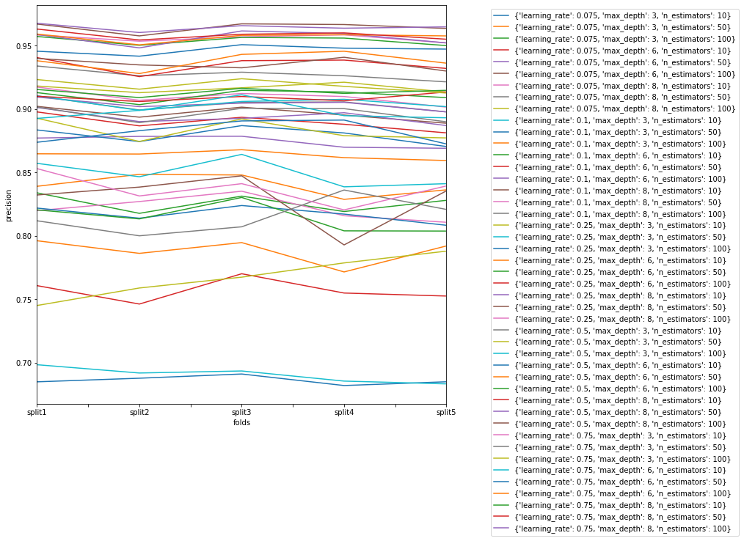
Results: Refined Machine Learning
*Data in this analysis used method 2 for jackknifing
Gradient Boosting
All models showed precision between 0.65 - 0.99
Notes:
In acoustic telemetry, fish are typically fitted with acoustic transmitter that emit a sound wave that is picked up by underwater acoustic receivers. The receiver records the date, time, and tagID of the individual that was within its detection range.
The transmitters used for this study were Vemco V9 transmitters. they randomly send out a signal every 100 to 180 seconds, have a battery life of about one year, and a nominal detection distance of about 500 m.

Slide 48
Results: Refined Machine Learning
*Data in this analysis used method 2 for jackknifing
Gradient Boosting
Simplest model with decent precision:
Learning_rate = 0.075, max_depth = 3, n_estimators = 100
Training data precision = 0.904
Testing data precision = 0.903
Most important parameters:
Depth gradient; year 2019, 2015, 2018; receiver density = 2; temperature; particular zones
Notes:
In acoustic telemetry, fish are typically fitted with acoustic transmitter that emit a sound wave that is picked up by underwater acoustic receivers. The receiver records the date, time, and tagID of the individual that was within its detection range.
The transmitters used for this study were Vemco V9 transmitters. they randomly send out a signal every 100 to 180 seconds, have a battery life of about one year, and a nominal detection distance of about 500 m.

Slide 49
Results: Refined Machine Learning
*Data in this analysis used method 2 for jackknifing
Gradient Boosting
How does this model perform without receiver density as a predictor?
Estimate shark presence when receivers aren’t present
Best model (based on precision):
Learning_rate = 0.75, max_depth = 8, n_estimators = 100
But all models still showed precision between 0.65 and 0.99
Notes:
In acoustic telemetry, fish are typically fitted with acoustic transmitter that emit a sound wave that is picked up by underwater acoustic receivers. The receiver records the date, time, and tagID of the individual that was within its detection range.
The transmitters used for this study were Vemco V9 transmitters. they randomly send out a signal every 100 to 180 seconds, have a battery life of about one year, and a nominal detection distance of about 500 m.

Slide 50
Results: Refined Machine Learning
*Data in this analysis used method 2 for jackknifing
Gradient Boosting (without Receiver Density)
Simplest model with decent precision:
Learning_rate = 0.075, max_depth = 3, n_estimators = 100
Training data precision = 0.916
Testing data precision = 0.9156
Most important parameters:
Depth gradient; year 2019, 2015, 2018; temperature; particular zones
Notes:
In acoustic telemetry, fish are typically fitted with acoustic transmitter that emit a sound wave that is picked up by underwater acoustic receivers. The receiver records the date, time, and tagID of the individual that was within its detection range.
The transmitters used for this study were Vemco V9 transmitters. they randomly send out a signal every 100 to 180 seconds, have a battery life of about one year, and a nominal detection distance of about 500 m.

Slide 51
Results: Refined Machine Learning
*Data in this analysis used method 2 for jackknifing
K Nearest Neighbors (without Receiver Density)
Tested:
Nearest Neighbors ranging from 1-30, uniform and distance weighting (grid search)
Best model (based on precision):
Nearest neighbors = 1, uniform weighting
Testing data precision = 0.999
Notes:
In acoustic telemetry, fish are typically fitted with acoustic transmitter that emit a sound wave that is picked up by underwater acoustic receivers. The receiver records the date, time, and tagID of the individual that was within its detection range.
The transmitters used for this study were Vemco V9 transmitters. they randomly send out a signal every 100 to 180 seconds, have a battery life of about one year, and a nominal detection distance of about 500 m.

Slide 52
Methods: Optimal Sample Size
*Data in this analysis used method 2 for jackknifing
Sample sizes using 2⁸ … 2^{n} … 2¹⁴ random samples
100 iterations for each sample size
Tested using the Decision Tree Classifier
Average precision score using cross_val_score with 3 folds
Notes:
In acoustic telemetry, fish are typically fitted with acoustic transmitter that emit a sound wave that is picked up by underwater acoustic receivers. The receiver records the date, time, and tagID of the individual that was within its detection range.
The transmitters used for this study were Vemco V9 transmitters. they randomly send out a signal every 100 to 180 seconds, have a battery life of about one year, and a nominal detection distance of about 500 m.

Slide 53
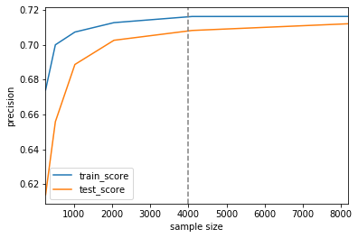
Results: Optimal Sample Size
*Data in this analysis used method 2 for jackknifing
Precision scores plateau around 4000 samples
Notes:
In acoustic telemetry, fish are typically fitted with acoustic transmitter that emit a sound wave that is picked up by underwater acoustic receivers. The receiver records the date, time, and tagID of the individual that was within its detection range.
The transmitters used for this study were Vemco V9 transmitters. they randomly send out a signal every 100 to 180 seconds, have a battery life of about one year, and a nominal detection distance of about 500 m.

Slide 54
Discussion: Choosing the Best Model
Best model should reduce the probability of false negatives (training data only where receivers are present)
Likely depends on the audience
Users that want to be able to understand how the decision was made
Decision Tree: Lay out the exact results but with lower confidence
Users that want just “shark likely present” vs “shark likely absent” with precision estimate
Gradient Boosting (high confidence)
K Nearest Neighbors (highest confidence, longer testing time)
Notes:
In acoustic telemetry, fish are typically fitted with acoustic transmitter that emit a sound wave that is picked up by underwater acoustic receivers. The receiver records the date, time, and tagID of the individual that was within its detection range.
The transmitters used for this study were Vemco V9 transmitters. they randomly send out a signal every 100 to 180 seconds, have a battery life of about one year, and a nominal detection distance of about 500 m.

Slide 55
Discussion: Choosing the Best Model
Likely depends on the audience
Users that want to figure out where to put receivers
Gradient Boosting or K Nearest Neighbors using previous environmental data for potential regions
Users that want to fill in gaps in historical data
K Nearest Neighbors (highest confidence)
Users that are studying a different species
Decision Tree can predict sound results at smaller sample sizes (n = 4000)
Notes:
In acoustic telemetry, fish are typically fitted with acoustic transmitter that emit a sound wave that is picked up by underwater acoustic receivers. The receiver records the date, time, and tagID of the individual that was within its detection range.
The transmitters used for this study were Vemco V9 transmitters. they randomly send out a signal every 100 to 180 seconds, have a battery life of about one year, and a nominal detection distance of about 500 m.

Slide 56
Discussion: Finding the Best Parameters
Shark presence at steeper depth gradients (T-Test; Decision Tree Classifier)
Juvenile White Sharks feed on soft-bodied prey in sediment¹
Might be easier to acquire prey at slightly steeper slopes
Yearly variance, particularly 2019
2019 was not yet over when project began
Each year has unique environmental characteristics
Makes filling in historical data easier
Makes predicting future data harder
1: Estrada, J. A., Rice, A. N., Natanson, L. J., & Skomal, G. B. (2006). Use of isotopic analysis of vertebrae in reconstructing ontogenetic feeding ecology in white sharks. Ecology, 87(4), 829-834.
Notes:
In acoustic telemetry, fish are typically fitted with acoustic transmitter that emit a sound wave that is picked up by underwater acoustic receivers. The receiver records the date, time, and tagID of the individual that was within its detection range.
The transmitters used for this study were Vemco V9 transmitters. they randomly send out a signal every 100 to 180 seconds, have a battery life of about one year, and a nominal detection distance of about 500 m.

